Slide 1
Select and Implement a SIEM Solution
Optimize IT security management and simplify compliance with SIEM tools.

Slide 2
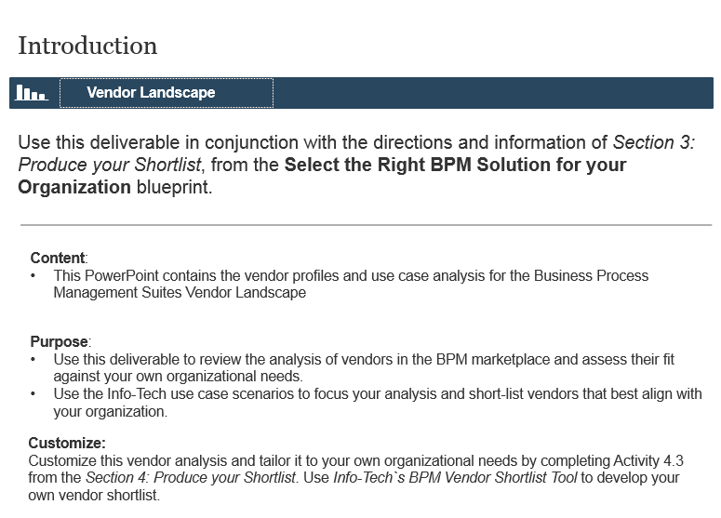
Use this blueprint and accompanying Vendor Landscape to support your SIEM selection and implementation
Use the project steps and activity instructions outlined in this blueprint to streamline your selection process and implementation planning.
Save time and money, and improve the impact of your SIEM procurement by leveraging Info-Tech’s research and project steps.
Launch your SIEM selection project and collect requirements
Phase 1
Use Info-Tech’s SIEM Vendor Landscape Analysis contained in Phase 2 of this project to support your vendor reviews and selection. Refer to the use-case performance results to identify the vendors that align with the requirements and solution needs identified by your earlier project findings.
Select your SIEM solution
Phase 2
Plan your SIEM implementation
Phase 3
Not everyone’s process needs are the same. These differences drive out different categories and niches within the Security Information and Event Management (SIEM) market space. Understand your own business’s processes and the unique technical and functional requirements that accompany them. Use your own set of requirements to determine the SIEM solution that best fits your organization.

Slide 3
Our Understanding of the Problem
IT or Security managers who wish to implement a Security Information and Event Management (SIEM) solution at their organization.
Organizations that want additional security and visibility into their network activity.
Organizations under stringent compliance obligations.
Select an appropriate SIEM solution based on vendor research.
Create an implementation roadmap.
Define your SIEM architecture.
Measure the continued value of your SIEM.
A formalized selection process to identify which SIEM solution is best for your organization to gain full visibility and analyze activity across your network.
An evaluation of the current SIEM products and vendors that can be customized to your organization through the Vendor Shortlist tool.
A completed selection process through the use of a Request for Proposal (RFP) template and a Vendor Demo Script to ensure that you are obtaining the correct information.
An implementation plan that includes the overall defining architecture of your final SIEM solution.

Slide 4
Executive Summary
Security threats continue to be more sophisticated and advanced with each day, with the majority often going completely undetected.
Organizations are usually scrambling to keep up and implement new security controls to protect themselves, which adds a new layer of complexity.
A SIEM isn’t for everyone. Review your appropriateness and create a formalized SIEM selection process to determine your needs.
A SIEM is not your only answer. Proper implementation and ongoing use is needed in order to maximize the benefits of a SIEM solution
With the rise of Advanced Persistent Threats (APTs) and insider attacks, it becomes extremely difficult for security staff to detect all the risks.
Many IT and IT Security staff are already stretched thin by keeping track of many different security technologies that already exist.
SIEM can provide a great deal of visibility into an organization’s networks and identify extremely sophisticated threats that may have otherwise been hidden.
By integrating with other security technologies, the SIEM solution can act as a single window into the threats and possible breaches that your organization is facing.
SIEM technology is also becoming more advanced with the capability to use advanced correlation engines as well as big data analytics to provide insightful analysis and forensics into the overall data.
Use Info-Tech’s research to gain more insight into which vendors and products are appropriate for your business, and follow our implementation to ensure that you are set up for success.

Slide 5
Info-Tech offers various levels of project support to best suit your needs
Consulting
Workshop
Guided Implementation
“Our team does not have the time or the knowledge to take this project on. We need assistance through the entirety of this project.”
DIY Toolkit
Info-Tech Involvement
“We need to hit the ground running and get this project kicked off immediately. Our team has the ability to take this over once we get a framework and strategy in place.”
“Our team knows that we need to fix a process, but we need assistance to determine where to focus. Some check-ins along the way would help keep us on track.”
“Our team has already made this critical project a priority, and we have the time and capability, but some guidance along the way would be helpful.”
Degree of Customization
Diagnostics and consistent frameworks used throughout four options

Slide 6
Select and Implement a SIEM Solution – Project Overview
1. Launch the SIEM selection project and collect requirements
2. Select a SIEM solution
3. Plan the SIEM implementation
Best-Practice Toolkit | 1. Assess value and identify fit. SIEM Appropriateness Tool 2. Build the procurement team and project plan. SIEM Procurement Project Charter Template 3. Identify the requirements for the SIEM. SIEM Use-Case Fit Assessment Tool | 4. Produce the vendor shortlist. SIEM Vendor Landscape Analysis SIEM Vendor Shortlist and Detailed Analysis Tool 5. Select a SIEM solution. SIEM RFP Template SIEM Evaluation and RFP Scoring Tool SIEM Vendor Demo Script | 6. Create an implementation plan. 7. Measure the value of the SIEM solution.
Guided Implementations | Start with an analyst kick-off call to identify your fit for a SIEM. Identify staffing needs and build a project plan. Gather your business, security, and IT requirements. | Create a shortlist based on your needs. Review findings with analyst and create your RFP. Conduct a contract review and select your SIEM solution. | Create an implementation plan. Set up your SIEM capabilities. Hand over your SIEM solution to your security operations.
Onsite Workshop | Module 1: Launch the SIEM selection project and analyze SIEM requirements | Module 2: Shortlist SIEM vendors and plan the procurement process | Module 3: Plan your SIEM implementation
 | Phase 1 Outcome: Launch your SIEM selection project. Gather and align requirements between IT and business. | Phase 2 Outcome: Shortlist your vendors based on your requirements. Select a vendor after writing a successful RFP and reviewing the contract. | Phase 3 Outcome: Plan the implementation of the SIEM solution and determine its evaluation.

Slide 7
GI and general value
Phase | Measured Value
Phase 1: Launch the SIEM selection project and collect requirements | Cost to assess value and identify fit: Consultant at $100 an hour for 4 hours = $400 Cost to build your procurement team and project plan: Consultant at $100 an hour for 40 hours = $4,000 Cost to identify the requirements for your SIEM Consultant at $100 an hour for 80 hours = $8,000
Phase 2: Select a SIEM solution | Cost to produce a vendor shortlist: Consultant at $100 an hour for 40 hours = $4,000 Cost to select your SIEM solution: Consultant at $100 an hour for 40 hours = $4,000
Phase 3: Plan the SIEM implementation | Cost to create an implementation plan Consultant at $100 an hour for 16 hours = $1,600 Cost to measure the value of your SIEM solution Consultant at $100 an hour for 8 hours = $800
Potential financial savings from utilizing Info-Tech resources: | Phase 1 ($12,400) + Phase 2 ($8,000) + Phase 3 ($2,400) = $22,800

Slide 8
Workshop overview
Contact your account representative or email Workshops@InfoTech.com for more information.
This workshop can be deployed as either a four or five day engagement depending on the level of preparation completed by the client prior to the facilitator arriving onsite.
Day 1 | Day 2 | Day 3 | Day 4 | Day 5
Preparation | Workshop Day | Workshop Day | Workshop Day | Working Session
Workshop Preparation Review your current log management process. Conduct interviews. | Morning Itinerary Identify the drivers behind the SIEM procurement. Complete the SIEM Appropriateness Assessment Tool. Afternoon Itinerary Identify the scope and purpose of the project. Select the staff resourcing. Identify stakeholders. | Morning Itinerary Create a project plan for SIEM selection. Determine metrics to evaluate selection process. Select the pilot. Afternoon Itinerary Determine your use-case scenario by completing the SIEM Use-Case Fit Assessment Tool. Analyze relevant Vendor Landscape use-case results. Customize vendor analysis. | Morning Itinerary Complete SIEM Vendor Shortlist and Detailed Analysis Tool. Create and prioritize solution requirements. Create an RFP to submit to vendors. Evaluate RFPs received. Afternoon Itinerary Create a demo script. Discuss the SIEM implementation plan. | Workshop Debrief Review documents. Next Steps Analyst calls to provide guidance during the selection and implementation processes.
The light blue slides at the end of each section highlight the key activities and exercises that will be completed during the engagement with our analyst team.

