Slide 1
Unify a Mixed Methodology Portfolio
Improve portfolio oversight and agility without going old school command and control.
Info-Tech's products and services combine actionable insight and relevant advice with ready-to-use tools and templates that cover the full spectrum of IT concerns.© 1997-2018 Info-Tech Research Group

Slide 2
ANALYST PERSPECTIVE
Reports of the death of scope, timeline, and budget commitments have been greatly exaggerated.
Certainly, when implemented properly, Agile and Agile-influenced approaches to project management have the potential to make project teams and IT departments more effective.
This doesn’t change the fact that a portfolio still needs be driven by the business –and portfolio management needs to speak the language of business leaders.
In this regard, portfolio managers and Agile practitioners alike need to do a better job of serving the business in this Agile-influenced paradigm. The former needs to ensure that portfolio processes are reasonable and accommodating to Agile and hybrid teams; the latter needs to accept that they’re not above being answerable to the core questions that drive executive engagement with the portfolio: What are you working on, when is it going to be done, and what’s it going to cost me?
Barry Cousins
Senior Director of Research, PMO Practice Info-Tech Research Group
SAMPLE

Slide 3
Our understanding of the problem
Project portfolio owners who lack visibility and desire more consistent and actionable data around project timelines and costs.
Portfolio managers who want to improve the responsiveness of their portfolios to changes in organizational direction and executive priority.
Portfolio managers who want to improve resource utilization across their portfolios.
Maintain greater visibility at the portfolio level into work-in-progress and committed work.
Facilitate more effective collaboration between stakeholders and teams by coordinating the steering process.
Maximize the value of each project interval, iteration, or sprint by improving prioritization process and readiness to start/stop work.
Project managers, product owners, and project leads who want to help improve portfolio oversight without altering the way they plan and execute projects.
Executive decision makers looking for more actionable commitments from their project teams.
Adhere to a standardized change control process for feeding the portfolio with the necessary data without interfering with project planning and execution routines and methodologies.
Provide a framework to synchronize approval commitments with project and sprint plans.
SAMPLE

Slide 4
Executive summary
As portfolio manager, you oversee a portfolio made up of projects using different types of planning and execution methodologies – from traditional Waterfall, to Agile, to hybrid approaches, and beyond.
This discontinuity makes a holistic and perpetually actionable view of the portfolio elusive – IT’s intake and resourcing decisions suffer in turn.
You can’t run a business on “velocity” and “story points” alone.
While our current Agile paradigm has given organizations the potential to make project teams more effective, this shouldn’t give Agile practitioners immunity from traditional portfolio oversight.
Decision makers still need to know on an ongoing basis what’s being worked on, when it’s going to be done, and what it’s going to cost them. It’s a portfolio manager’s job to facilitate this information for all projects, regardless of methodology. .
While the executive layer is demanding greater portfolio visibility from you, many Agile practitioners see themselves as being above traditional project constraints, including timeline, scope, and budget.
Agile’s influence has made it easier to start projects, but a comparable ease has not been enforced when it comes to cancelling or pausing projects, leading to rampant supply-demand and throughput challenges.
Establish universal control points. While the manager of a mixed methodology portfolio doesn’t need to enforce a standardized project methodology, she or he does need to establish universal control points for both intake and reporting at the portfolio level. Use this research to help you define a sustainable process that will work for all types of projects.
Scale the approvals process. For a mixed methodology portfolio to work, the organization needs to reconcile different models for approving and starting projects. This blueprint will help you define a right-sized intake process and decision-making paradigm for sprints and project phases alike.
Foster ongoing executive engagement. Mixed methodology success is contingent on regular and ongoing executive engagement. Use the tools and templates associated with this blueprint to help get buy-in and commitment upfront, and then to build out portfolio reports and dashboards that will help keep the executive layer informed and engaged long term.
SAMPLE

Slide 5
As project methodologies morph and proliferate, PMOs are increasingly struggling to make sense of the whole
Portfolio management for IT was always challenging, but the proliferation of Agile and Agile-influenced project methodologies has made sustained portfolio visibility more elusive.
Most PMOs are responsible for portfolios made up of initiatives being planned and executed using a mix of different project management methodologies.
We call these “mixed methodology portfolios.” For most organizations, these are project-driven (i.e. bottom-up) portfolios that largely lack universal requirements for feeding the portfolio with data or standardized governance of any kind.
To date, the portfolio management industry has largely tried to accommodate this proliferation with project methodologies, building project-portfolio interactions around project management requirements.
This approach is largely failing. Project management shouldn’t influence your portfolio management methodology. Projects should serve the portfolio (not the other way around), providing the data that the portfolio needs to offer insights to the organization’s executive decision-making layer.
80%
80% of organizations use more than one type of project management methodology within their project portfolios.
– KPMG, 2017
47%
47% of large organizations use hybrid project management methodologies.
– Muir, 2015
SAMPLE

Slide 6
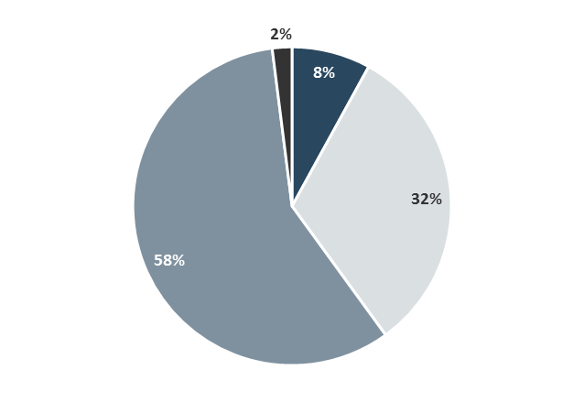
The proliferation of mixed methodology portfolios can be attributed to the rise of Agile, but Agile isn’t the whole story
The answer to the challenges of a mixed methodology portfolio isn’t as simple as saying the portfolio needs to “go Agile,” though portfolio and business agility is certainly a goal.
Most IT organizations now have some Agile projects, and the numbers show Agile’s footprint is growing.
Even organizations that don’t formally use Agile methods have adopted “agilistic” tendencies, such as mitigating risk with shorter, more iterative development cycles and increasing collaboration with stakeholders.
However, the numbers show that Agile’s takeover is far from total in IT, and even if we hit “peak Agile,” every organization will continue to have some traditionally planned projects – such as capital-intensive infrastructure projects – even if people don’t want to call them Waterfall.
What’s more, as popular as it is to talk Agile and Waterfall, ad hoc and hybrid methodologies are actually most common in day-to-day IT.
Percentage of Teams Using Agile*
All of our teams are Agile
None of our teams are Agile
Less than half of our teams are Agile
More than half of our teams are Agile
2nd
In 2015, the second most popular project management methodology behind Waterfall was “no standard methodology.”**
65%
65% of Agile organizations are deliberately choosing to blend Agile with other methodologies to improve results.***
*Version One, 2017
**Boonie, 2015
***Muir, 2015
SAMPLE

Slide 7
Bottom-up driven mixed methodology portfolios are failing the executive layer
Portfolio management should serve the executive layer with insight. In our current mixed methodology paradigm, the numbers show that it’s largely failing.
89% of executives say they lack an integrated view of their portfolios across the enterprise, making portfolio decisions difficult and poorly informed.
89%
– PMI, 2015
60%
Over 60% of executives say the struggle making go/kill decisions is due to poor/inadequate portfolio data.
– AIPMM, 2011
Over 60% of executives note the struggle to reconcile bottom-up and top-down plans.
60%
– AIPMM, 2011
47% of unsuccessful projects are impacted by poor decision making.
47%
– PMI, 2015
As these statistics reveal, without a strong portfolio management practice to help integrate project level data, the decision-making layer is very much flying blind.
SAMPLE

Slide 8
Corporate leaders are starting to push back against portfolio chaos
The pendulum is swinging back from the Agile dream of perpetual freedom from scope, timeline, and budget commitments to the executive reality of shareholder accountability.
While many IT organizations are realizing the benefits of Agile at the level of software delivery, this doesn’t change the fact that the methodology has a spotty reputation amongst the C-suite.
In principle, Agile really does borrow from the great parts of the pre-internet era by allowing people to focus on fewer tasks, at least conceptually. It is supposed to reduce the wasted time and leave people alone to produce value.
Sadly, that “leave people alone” pendulum has swung too far.
The executive decision maker still wants to know what you’re doing, when it’s going to be done, and what it’s going to cost. For the Agile purist, the answers are, respectively: Whatever we decide in sprint planning; whenever you tell us to stop, and; whatever it has costed when we stop.
This is not making Agile a popular conversation topic among affected executives.
Three-quarters of CIOs
Three-quarters of CIOs surveyed in the US and the UK said they were no longer prepared to defend Agile to the business. Half said they now think of agile as “an IT fad.”
– Angel, 2017
[in Agile] individual engineers are rewarded or punished solely based on the optics of the current two-week “sprint”, meaning that no one looks out five “sprints” ahead. Agile is just one mindless, near-sighted “sprint” after another: no progress, no improvement, just ticket after ticket after ticket.
– Michael O. Church, 2015
SAMPLE

Slide 9
While firmer project commitments are needed, portfolio leaders should also demand a more engaged executive layer
A disengaged executive layer is a major barrier to mixed methodology portfolio success.
In a traditional portfolio, the portfolio owners (CIO, steering committee, etc.) approve projects and passively await status updates on those projects.
The portfolio manager must continually find a way to get those projects completed with the resources they have at their disposal, negotiating dates with the portfolio owners based on their view of capacity.
This is particularly complex when the portfolio managers don’t actually control the amount of time that the project teams spend on the projects – which is largely the case across the industry.
After nearly three decades, this approach has largely resulted in portfolio owners approving too much work – with throughput, quality, and employee morale suffering as a result.
2% of Agile practitioners
63% of failed Agile implementations
Only 2% of Agile practitioners feel that executives are knowledgeable about Agile practices.
– McKendrick, 2013
A clash between business culture and Agile values was blamed in 63% of failed Agile implementations.
– VersionOne, 2017
SAMPLE

Slide 10
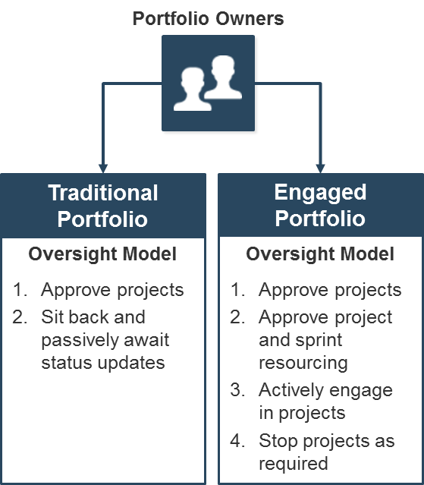
Projects don’t get done by approvals; they get done through effective stewardship of the organization’s resources
Project agility should help drive business agility, assuming that the portfolio is itself responsive.
In a mixed methodology portfolio, a more engaged executive layer is required than what we see in a traditional portfolio approach. Portfolio owners have to decide what gets worked on at a regular cadence.
What’s the difference? In the old paradigm, nobody stopped the portfolio owners from approving too much. Decisions were based on what should be done, rather than what could get done in a given period, with the resources available.
The engaged portfolio succeeds by making sure that the right people work on the right things as much as possible.
The portfolio owner plays a key, ongoing role in identifying the work that needs to be done, and the portfolio managers optimize the usage of resources.
A mixed methodology portfolio works best when it manifests itself as what we call an Engaged Agile Portfolio: a portfolio of projects managed tightly, in short-term iterations, with close engagement of customers, sponsors, and stakeholders
SAMPLE

Slide 11
Get project teams and decision makers in sync with right-sized yet firm project standards
Follow Info-Tech’s mixed methodology portfolio approach to align your executive layer with your project managers and teams.
Follow the approach in this research to ensure your portfolio practices around intake and prioritization, resource management, and portfolio reporting are optimized and helping to:
Align the goals and vocabularies of project teams and executive decision makers.
Bridge the gaps in the tactical outlooks and plans of both layers.
Goals
Outlook
Nomenclature
Executive Management and Stakeholders
Strategic alignment
Achieving business goals
Growing the business
Predictive and prescriptive approach to planning
Outlook : 2-4 quarters
Timelines
Roadmaps
Priorities
Strategy
Benefits
ROI
Portfolio Manager/PMO Director
Intake and Prioritization Discipline
Resource and Capacity Forecasts
Portfolio Reporting
Project Managers and Agile Teams
Getting things done
Addressing sponsor and customer needs
Iterative and incremental approach to planning
Outlook: 2 sprints/4 weeks
Sprints
Story points
User stories
Velocity
Table adapted from “Agile + Portfolio Management”, Innotas
SAMPLE

Slide 12
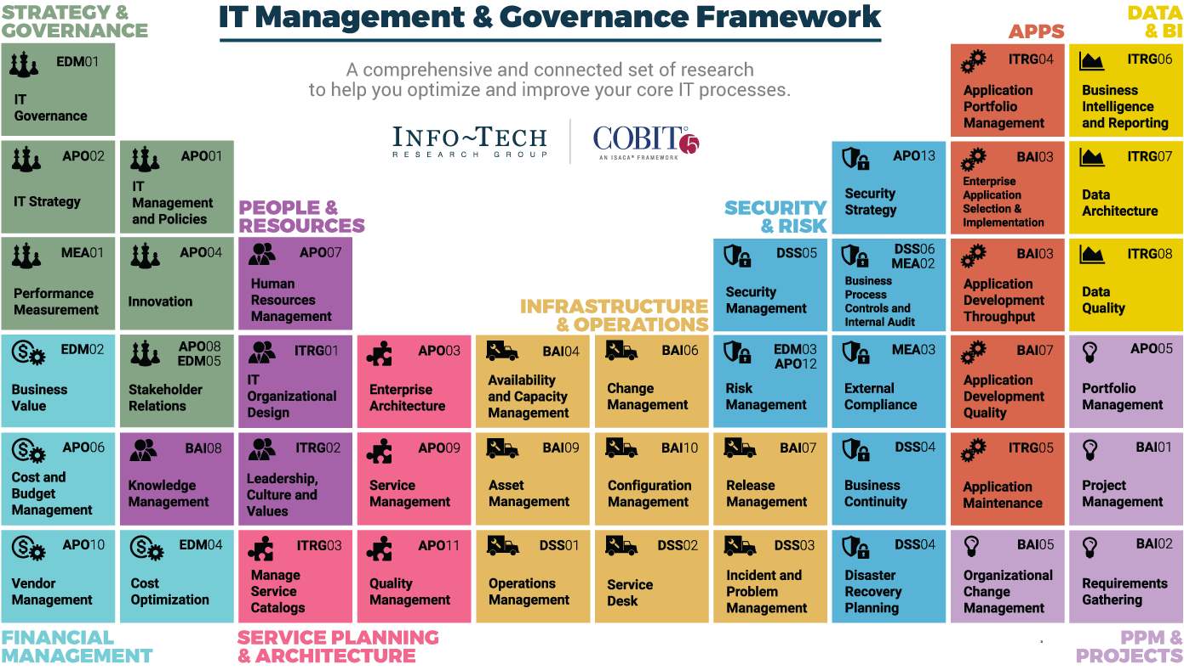
Dive Deeper Into Our Research
by Clicking One of the Elements Below
Find out how Info-Tech makes your job easier. Contact Us Today: Toll-Free (US & Canada): 1-888-670-8889
Info-Tech Research Group
SAMPLE

