Slide 1
Grow Your Own PPM Solution
46% of organizations use a homegrown PPM tool. Here’s a better way to do it.
Info-Tech's products and services combine actionable insight and relevant advice with ready-to-use tools and templates that cover the full spectrum of IT concerns.© 1997–2017 Info-Tech Research Group

Slide 2
ANALYST PERSPECTIVE
Almost half of the market uses a homegrown PPM solution, but most of them have under-developed their solution.
Commercial vendors offer powerful and compelling PPM options for properly resourced organizations that have project teams with the process discipline to maintain the data within these tools.
For many organizations—e.g. those that lack robust PPM maturity and/or adequate time – these tools prove to be too much machinery for the job. For them, the tools impose unsustainable process overhead on users and produce unusable portfolio data – an unfortunate outcome, especially given the hefty costs associated with these tools.
For the resource-constrained, a spreadsheet-based solution can produce compelling results. Spreadsheets can be more easily customized to better promote adoptability and sustainability. And with the Power BI (Business Intelligence) features in Excel, the functionality gap between spreadsheets and commercial offerings has been considerably narrowed.
Barry Cousins,
Senior Director, PMO Research Info-Tech Research Group

Slide 3
Our understanding of the problem
PMO directors and CIOs who are looking to implement an effective, affordable, and adaptable PPM solution.
PMO directors and CIOs who want to establish PPM process discipline before investing in a costly commercial solution.
PMO directors who are looking to complement existing PPM solutions that address organization-specific needs.
Implement an effective PPM solution, with which to:
Visually communicate portfolio status and capacity to executives and decision makers.
Reclaim capacity through more effective project prioritization and resource optimization.
Evaluate incoming projects and prioritize those that best align with organizational goals.
Add and modify functionalities to address organization-specific needs.
IT managers who want an effective and lightweight tool to help oversee multiple projects on one dashboard.
IT managers who want a simple way to manage and track resource allocations.
Prioritize and manage projects through the full project lifecycle (from inception to post-completion).
Measure, manage, and optimize resource allocations across different projects and types of work.

Slide 4
Executive summary
As portfolio manager, you’re responsible for supporting the intake of new project requests, providing visibility into the portfolio of in-flight projects, and helping to facilitate the right approval and prioritization decisions.
You need a project portfolio management (PPM) tool that promotes the maintenance and flow of good data to help you succeed in these tasks.
1. Don’t be held hostage to adoption. Lack of adoption is the number one barrier to PPM tool success. While buy-in from project teams is important, your ability to manage your portfolio shouldn’t be subservient to it. An effective PPM tool should be, to some extent, autonomous from the specifics of project level adoption.
2. Emphasize interaction over documentation. The job of a PPM tool is to facilitate and support conversations and decisions. Organizations often fail at PPM when updating and maintaining data in the tool becomes the end in itself.
Commercial vendors offer powerful and compelling options, but they are costly and, in order to generate useable data, they require a consistency of adoption that, historically, your teams haven’t been able to sustain.
Leadership wants portfolio visibility but are also protective of project resources. A tool that requires a significant injection of process overhead is sure to be rejected by project teams and executives alike.
Think outside the commercial box. Commercial options offer extensive features, but can impose heavy requirements on project managers and teams for immature and evolving processes. A rudimentary spreadsheet based solution can be a better fit, especially for organizations that lack PPM maturity. Spreadsheets provide an easy-to-customize solution that can grow as your PPM maturity evolves.
Make it sustainable. When it comes to portfolio management, high level is better. A tool that is accurate and maintainable will provide more value than one that strives for precision of data, yet is ultimately unmaintainable. What you sacrifice in near-term precision you’ll make up for in long-term adoptability and useable portfolio data.
Report success. Ultimately, a PPM tool needs to foster portfolio visibility in order to engage and inform the executive layer and support effective decision making. Your PPM solution needs to facilitate effective and targeted reporting in order to improve the engagement of senior leaders in PPM and help improve PPM performance.

Slide 5
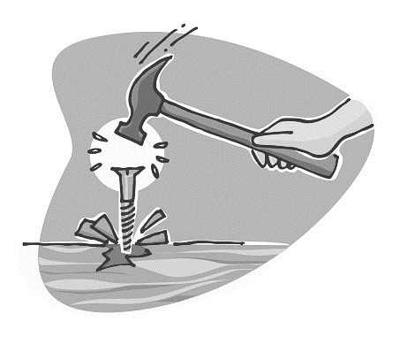
Effective portfolio management requires unique portfolio management solutions
Without the right tool for the job, you risk depleting stakeholder trust trying to provide portfolio visibility with a tool built for more tactical project management concerns.
While portfolio management and project management are interdependent, they are ultimately separate disciplines that require unique tools and processes.
When organizations seek portfolio visibility from what are, in fact, primarily project management solutions, they inevitably struggle to achieve the big picture.
The typical pitfalls of a PPM solution include:
Visibility is commonly thwarted by a lack of project-level adoption.
Data quality and reporting capabilities often fall short of what decision makers require to make the right project choices.
Leading project management systems offer a portfolio view. The problem is that they are more administratively than strategically oriented. They build the portfolio from the operational level up and are designed for project professionals, which makes them too complicated for business users.
– Lee Merkhofer

Slide 6
Working without a PPM solution allows time and money to vanish without being accounted for
Think of the PMO/portfolio manager as the Accounting Department for time.
Without a PPM solution to provide insight into the big picture, poor project investment decisions will inevitably get made.
Time and money get malinvested in projects that fail to yield returns, either because they don’t get completed – due to feasibility or capacity constraints – or because they are inherently of low value to begin with.
While it might be unrealistic to count every work hour, you can have the ability to estimate your capacity for new projects and avoid these pitfalls:
Time and money wasted on cancelled projects
Unutilized resources
Mismatched skills
1/6
IT Projects
One in six IT projects has an average cost overrun of 200% and a schedule overrun of 70%.
– HBR, 2011
Organizations lose an average of $109 million USD for every $1 billion USD spent on projects.
– PMI, High Cost of Low Performance, 2014
80%
of IT teams
$109
million
USD
Eighty percent of project teams spend at least half their time reworking already completed tasks
– Geneca

Slide 7
The right PPM tool can help save time and money by improving project and portfolio outcomes
44%
An effective PPM tool increases the likelihood of completing projects on time or early by 44%.
38%
An effective PPM tool increases the likelihood of completing projects on budget by 38%.
– Aberdeen Group
– Aberdeen Group
52%
A project hitting its expected ROI is 52% more likely with an effective PPM tool.
40%
An effective PPM tool can help reduce discretionary spending on a portfolio of projects by 40%.
– Aberdeen Group
– EclipsePPM
Finding the “right” PPM tool is the key.
There is no one-size-fits-all PPM solution. Choosing the right one depends on finding the right match for your organization’s culture and PPM maturity.
255%
Implementing an effective PPM solution can produce an expected overall return of up to 255%.
– Craig Symons

Slide 8
Implementing the wrong PPM tool can be a costly mistake
Success statistics aside, the fact remains that implementing a PPM tool can be risky. Commercial solutions are costly, and their success is far from guaranteed.
Despite the considerable growth of the commercial PPM tool market in recent years, the statistics around IT project failure remain consistently bleak.
The US economy loses as much as $150 billion per year due to failed IT projects.
– Gallup
—Gallup
$150
billion
$3.9
Billion
Only 29% of projects were delivered on time, on budget, and with satisfactory results in 2015.
The global PPM market grew to $3.9 billion in 2013, and is projected to reach $5.7 billion by 2018.
29%
of projects
– IDC
– Hass and Fulmer

Slide 9
The software industry has mostly missed the mark when it comes to addressing portfolio management challenges
[M]any vendors entered the portfolio space by augmenting their existing project management tools, [so] it should not be surprising that so many PPM tools provide strong project management features even though they may lack portfolio optimization capability.
An industry insider put it this way, ‘As interpreted by the software industry today, PPM is about managing the execution of project work after the decision is made to do the work.’
– Merkhofer
Seventy-six percent of organizations say they have too many projects on the go and an ever-growing backlog of things to get to.
76%
Forty-seven percent of unsuccessful projects are impacted by poor decision making.
47%
– PMI, 2015
– Cooper

Slide 10
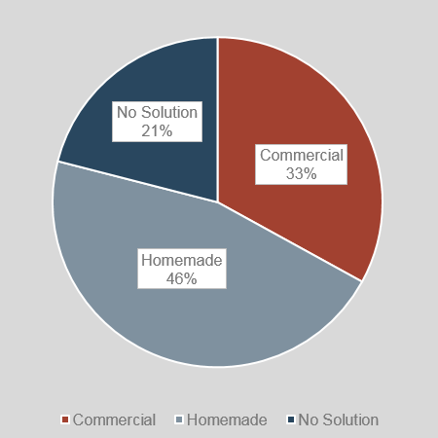
Your PPM tool options are not limited to commercial offerings
Kinds of PPM solutions used by Info-Tech clients
Despite the growth in the commercial PPM market, homegrown approaches like spreadsheets and intranet sites continue to be the most common PPM tool.
While homegrown solutions lack the robust functionality of commercial offerings, they have dramatically lower complexity and cost-in-use.
Because these solutions don’t require coordinated and continual adoption by the project teams, projects managers, and executives, they are far more feasible to implement and maintain over time.
While spreadsheets can be created with minimal cost and effort, it’s important to remember: when something is easy to do, it’s also easy to do badly.
With 46% of its clients relying on homegrown options to manage their portfolios, Info-Tech has developed an optimized spreadsheet-based solution with enhanced capabilities around project and resource visibility.
!
Source: Info-Tech Research Group (2016), N=433

Slide 11
PPM solutions succeed when they help to plan and manage the whole, not just individual parts
A tool that doesn’t reliably integrate project data into an understanding of the portfolio as a whole misses the whole point of having a PPM tool.
Project portfolio management is comprised of four key strategic capabilities:
Select the right projects (i.e. project intake, approval, and prioritization)
Pick the right time and people to execute those projects (i.e. resource management)
Make sure projects are okay and that they get done (i.e. status and progress reporting)
Make sure projects were worth doing in the first place (i.e. benefits tracking)
A PPM solution needs to explicitly assist portfolio managers and executive decision makers in these capabilities, helping to ensure that the projects are of value and make sense within the context of IT’s ability to execute them.

Slide 12
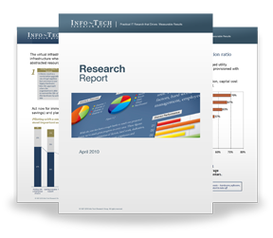
Info-Tech Research Group Helps IT Professionals To:
Quickly get up to speed with new technologies
Make the right technology purchasing decisions – fast
Deliver critical IT projects, on time and within budget
Manage business expectations
Justify IT spending and prove the value of IT
Train IT staff and effectively manage an IT department
Sign up for free trial membership to get practical
solutions for your IT challenges
“Info-Tech helps me to be proactive instead of reactive – a cardinal rule in a stable and leading edge IT environment.
- ARCS Commercial Mortgage Co., LP
Toll Free: 1-888-670-8889
www.infotech.com

