Slide 1

Vendor Landscape: Online Casino Platforms
Choosing the right partner is critical when bringing your brick and mortar into the online world.
Info-Tech's products and services combine actionable insight and relevant advice with ready-to-use tools
and templates that cover the full spectrum of IT concerns.© 1997 - 2013 Info-Tech Research Group

Slide 2
Introduction
As gaming markets open up, operators are vying to establish and advance their brand among patrons both new and old. To do this successfully, most are looking for the right partner with which to venture into this virtual world.
This Research Is Designed For:
This Research Will Help You:
Operators seeking to select a platform for managing an online casino.
Online gaming use case may include:
  Promoting an existing brick and mortar casino brand.
  Creating a new online brand and casino.
Understand what’s new in the online gaming market.
Evaluate online gaming vendors and platforms for your enterprise needs.
Determine which products are most appropriate for particular use cases and scenarios.

Slide 3

Market Overview
How it got here
Where it’s going
Internet gaming started seeing real growth following the Free Trade and Processing Zone Act in Antigua. It wasn’t long before companies began developing solutions to feed this new market, with Microgaming gaining an early lead.
In October 1996, InterCasino launched the first internet casino that could take actual money bets. Within three years, 700 internet casinos popped up taking real money wagers.
The industry continued to develop with Boss Media, the first to offer multi-player games, allowing players to interact with one another and form communities.
The Unlawful Internet Gambling Enforcement Act (UIGEA) of 2006 set the industry back. While iGaming has continued to bloom in markets abroad, the US has always had tense relations with regulators. Today there are three states that offer varying degrees of regulation (New Jersey, Nevada, and Delaware) and the expectation is that other states will follow.
The future of the iGaming market is somewhat of a mystery at this point. There’s a lot of speculation as to whether regulations will continue to shift slowly state by state, or whether a federal change will take place. This is crucial because the key to profiting from iGaming will likely come down to leveraging interstate liquidity. With so many eager players, erasing the borders between customers could be the only path to survival.
As regulations loosen in the US, online poker looks as though it may be treated a little more leniently than other types of gambling. Online poker has always been a popular product, often used as a marketing gateway to the other types of online betting (e.g. sports, casino).
Currently, a lot of organizations have created play-for-fun sites. While these don’t support actual gambling, they have been used as a marketing device for brick and mortar operations. Moreover, play-for-fun sites develop an online brand that could potentially be leveraged once play-for-pay sites are legalized.
As the market evolves, capabilities that were once cutting edge become default and new functionality becomes differentiating. Supporting game content from third-party providers has become a Table Stakes capability and should no longer be used to differentiate solutions. Instead focus on marketing and social media capabilities to get the best fit for your requirements.

Slide 4
















Defining online gaming
Online gaming, or iGaming, comes in many shapes and forms. You won’t necessarily need all of the pieces right now, or ever, but understanding the difference is a good place to start.
While many vendors offer turnkey solutions (featuring both platform and content), some vendors specialize in certain aspects of iGaming, and some don’t target casinos whatsoever.
Understand the different categories of vendors to leverage each vendor for its strengths.
This Vendor Landscape focuses on those that provide a platform for online casino operations. These can include full turnkey solutions, as well as platforms that will need to be complimented with other vendor offerings such as poker, bingo, or additional slot content.
Platform | Turnkey
Social/Other | Content
Platform
Content

Slide 5
Online Casino Platform Vendor selection / knock-out criteria: market share, mind share, and platform coverage
The industry is at a high point of tension as the world, and especially the United States, waits to see how regulations will fall. Given this uncertainty and the unfamiliar nature of online casinos to most operators, Info-Tech has chosen experienced vendors who have already proven themselves in regulated, legal markets.
For this Vendor Landscape, Info-Tech focused on those vendors that offer broad capabilities across multiple platforms and that have a strong market presence and/or reputational presence among mid to large-sized enterprises.
Included in this Vendor Landscape:
888. 888 Holdings has a large online gaming presence, particularly in the poker area. It launched its first online casino product in 1997 called Casino-on-Net and has since entered into other areas of online gaming such as bingo and sports betting.
Amaya. Amaya is a Canadian company that has always been focused on the iGaming market. It has grown substantially in the last few years, first through its business arrangement with Chartwell Technology, Inc., and then its acquisition of Cryptologic Limited.
Aristocrat. This Australian-based company is one of the largest gaming machine manufacturers in the world. Aristocrat’s online gaming offering has grown significantly, including a partnership with Ongame to provide online poker.
Bally. Bally is one of the most trusted names in land-based gaming with more than 80 years of experience in casino machine manufacturing. Bally’s iGaming platform is a fairly new offering, but is supported by Bally’s legacy of well known casino systems and machines.
Gamesys. A relatively new player compared to the rest of the vendors being considered, but it has rapidly earned a name for itself through its popular and addictive social games. It has recently branched into social casino gaming. While it doesn’t commonly offer a full solution to operators, it has partnered with operators in the past, such as Caesars.
GTECH. Part of the newly re-branded GTECH S.p.A group (formerly Lottomatica Group), GTECH combines SPIELO game technology with the GTECH online experience to offer a variety of online gaming products including casino, sports betting, content, bingo, and lottery.

Slide 6
Online Casino Platform Vendor selection / knock-out criteria: market share, mind share, and platform coverage
Included in this Vendor Landscape, Continued:
Microgaming. Microgaming has always been central to this market. It’s credited with creating one of the first virtual casinos in 1994 and is recognized as one of the world’s largest providers of online gaming software.
OpenBet. OpenBet is a UK-based company, focused exclusively on online gaming. It has online casino, poker, and sports-betting modules with a single centralized account.
Playtech. Playtech has always been committed to the persistent improvement and expansion of its gaming offerings. It offers cross-platform solutions, providing a single account for online, mobile, and server-based games.
Scientific Games Sciplay. Sciplay is a wholly owned subsidiary of Scientific Games Corporation, and provides a turnkey solution including system software, game content, operational services, and player support.
Williams Interactive. Williams Interactive was formed by WMS Industries in July 2012 to focus solely on iGaming, creating an end-to-end solution for online operators. Scientific Games recently announced that it is acquiring WMS Industries to further expand its online offering.

Slide 7
Online Casino Platform criteria & weighting factors
Product Evaluation Criteria
Criteria Weighting:
Features
The solution provides basic and advanced feature/functionality.
Features
Usability
Usability
The end-user and administrative interfaces are intuitive and offer streamlined workflow.
Integration
Extensive integrations with both online content and core casino systems.
Architecture
Integration
Architecture
Multiple deployment options and extensive scalability capabilities are available.
Product
Vendor Evaluation Criteria
Viability
Vendor is profitable, knowledgeable, and will be around for the long term.
Strategy
Vendor is committed to the space and has a future product and portfolio roadmap.
Vendor
Viability
Strategy
Reach
Vendor offers global coverage and is able to sell and provide post-sales support.
Partners
Vendor has established effective strategic partnerships to enhance its offering to the client.
Partners
Reach

Slide 8
Table Stakes represent the minimum standard; without these, a product doesn’t even get reviewed
The Table Stakes
What Does This Mean?
Feature
What it is:
The products assessed in this Vendor LandscapeTM meet, at the very least, the requirements outlined as Table Stakes.
Many of the vendors go above and beyond the outlined Table Stakes, some even do so in multiple categories. This section aims to highlight the products’ capabilities in excess of the criteria listed here.
Cashier Functionality
Allows players to deposit and withdraw cash automatically.
Slot Functionality
Platform is able to support basic slot games.
Responsible Gaming
Supports features including age verification, deposit limits, and self-exclusion.
Native Content
Comes complete with some games which can be either proprietary or from third-party providers.
If Table Stakes are all you need from your Online Casino Platform solution, the only true differentiator for the organization is price. Otherwise, dig deeper to find the best price to value for your needs.

Slide 9
Advanced Features are the capabilities that allow for granular market differentiation
Scoring Methodology
Advanced Features
Info-Tech scored each vendor’s features offering as a summation of their individual scores across the listed advanced features. Vendors were given one point for each feature the product inherently provided. Some categories were scored on a more granular scale with vendors receiving half points.
Feature
What we looked for:
Bank Options
Gives users the choice of making deposits through debit, credit, or e-wallets.
Marketing and Loyalty
Incorporates targeted marketing, promotion and performance tracking, and/or loyalty systems.
Multi-Currency
The platform is able to support payouts and deposits in multiple currencies.
Multi-Lingual
The platform is able to support multiple languages including double byte.
Multi-Player Games
Users can play against other live players rather than just against computer-generated players.
Reporting
Stock reporting templates and/or customizable templates come built into the solution.
Security
Features advanced layer security with 40-bit SLL, a dedicated VPN, and security licenses.
Virtual Currency
Configurable for playing real money for virtual goods including extra lives, bonus features, etc.
White-Label Capability
Platform is fully customizable, including dealers, casino lobby, card backs, table appearance.
For an explanation of how Advanced Features are determined, see Information Presentation – Feature Ranks (Stop Lights) in the Appendix.

Slide 10
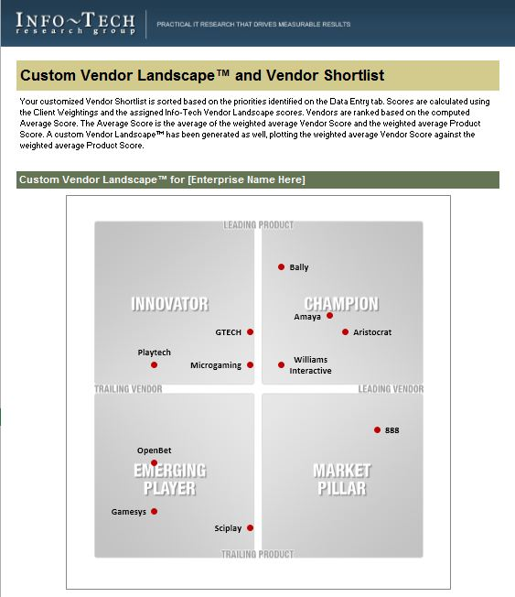
Identify leading candidates with the Online Casino Platform Vendor Shortlist Tool
The Info-Tech Online Casino Platform Vendor Shortlist Tool is designed to generate a customized shortlist of vendors based on your key priorities.
This tool offers the ability to modify:
Overall Vendor vs. Product Weightings
Individual product criteria weightings:
Features
Usability
Integration
Architecture
Individual vendor criteria weightings:
Viability
Strategy
Reach
Channel

Slide 11
Appendix
Vendor Landscape Methodology: Overview
Vendor Landscape Methodology: Product Selection & Information Gathering
Vendor Landscape Methodology: Scoring
Vendor Landscape Methodology: Information Presentation
Vendor Landscape Methodology: Fact Check & Publication

Slide 12


Info-Tech Research Group Helps IT Professionals To:
Quickly get up to speed
with new technologies
Make the right technology
purchasing decisions – fast
Deliver critical IT
projects, on time and
within budget
Manage business expectations
Justify IT spending and
prove the value of IT
Train IT staff and effectively
manage an IT department
Sign up for free trial membership to get practical
solutions for your IT challenges
“Info-Tech helps me to be proactive instead of reactive –
a cardinal rule in a stable and leading edge IT environment.
  - ARCS Commercial Mortgage Co., LP
Toll Free: 1-888-670-8889
www.infotech.com

