Slide 1

Vendor Landscape: Web Experience Management
Great customer experiences bring in revenue, but are going to cost you time and money.
Info-Tech's products and services combine actionable insight and relevant advice with ready-to-use tools
and templates that cover the full spectrum of IT concerns.© 1997 - 2013 Info-Tech Research Group

Slide 2
Introduction
Organizations that have a website centered marketing strategy should manage the experience in the same manner.
This Research Is Designed For:
This Research Will Help You:
Enterprises seeking to select a solution for Web Experience Management (WEM).
WEM use case may include:
  Organizations that want to deliver dynamic content as part of marketing initiatives.
  Organizations that want to expand their digital presence to mobile devices, including the development of mobile apps.
  Organizations looking to align their marketing campaigns across multiple channels.
Understand what’s new in the WEM market.
Evaluate WEM vendors and products for your enterprise needs.
Determine which products are most appropriate for particular use cases and scenarios.
Info-Tech Insight
Web Experience Management is about the creation of tailored experiences and converting website visitors into customers and fans.
Look at Info-Tech’s Vendor Landscape: Web Content Management for additional web management solutions that focus on giving control over content management to marketing departments.

Slide 3

Market Overview
How it got here
Where it’s going
Large enterprises with multiple consumer brands needed a solution to control multiple separate company websites.
WCM tools evolved to include several role-based tools that could manage content across websites at the level of individual content pieces.
Legacy vendors such as Day, Vignette, and RedDot brought simple, easy-to-use user interfaces allowing other departments to participate in website design and management.
Autonomy’s IDOL engine pioneered using search and analytics as a platform to match content to user persona.
The large vendors consolidated WCM products with analytics, search, and CRM products thus creating a separate class of products collectively known as Web Experience Management (WEM).
The market will continue to add vendors as traditional WCM vendors add robust search and consolidated analytics to their products.
The increased pressure to align across all potential channels (web, mobile, email, social, and print) will lead more vendors to bring social management tools directly into the WEM product.
As the offerings mature, the products will have to increase the number of potential customer interactions to drive and monitor consumer web experience.
The increasing ability of WEM to be deployed on the cloud will drive competition for mid-market clients.
The increased amount of data generated by websites is driving demand for integration of a wider analytics platform.
The big data phenomenon will start to shape WEM product marketing.
As the market evolves, capabilities that were once cutting edge become default and new functionality becomes differentiating. Template control, mobile responsive design, and content editing have become Table Stakes capabilities and should no longer be used to differentiate solutions. Instead, focus on integrated analytics and multi-channel support to get the best fit for your requirements.

Slide 4
Web Experience Management Vendor selection / knock-out criteria: market share, mind share, and platform coverage
Trends in WEM include: optimized mobile delivery, content analytics, multi-channel support, and consolidated management tools. All vendors included in this landscape have solutions for some, if not all, of these emerging trends.
For this Vendor Landscape, Info-Tech focused on those vendors that offer broad capabilities across multiple platforms and that have a strong market presence and/or reputational presence among mid-sized and large enterprises.
Included in this Vendor Landscape:
Acquia. A Drupal-based solution delivered by Acquia. Acquia delivers affordable WEM features for organizations on a budget.
Adobe. The integration of the content management, publishing, and marketing tools gives Adobe broad appeal.
Autonomy, an HP company. A solution with strong search capabilities, Autonomy offers an enterprise level WEM product.
Bridgeline. A new entrant with a strong e-commerce background.
CoreMedia. Brings a strong video delivery platform to the WEM landscape.
Ektron. Ektron provides a capable WEM solution. The digital hub module provides flexibility to the platform.
EPiServer. Its e-commerce background matched with a new focus on analytics provides a solid platform for growth.
Kentico. Positioned as a global mid-market player, Kentico offers a flexible product at an affordable cost.
OpenText. OpenText’s scalable WEM solution can meet enterprise level requirements.
Oracle. The acquisition of FatWire Software in 2011 has enabled Oracle to add key functionalities to its WEM product.
SDL. SDL’s robust WEM solution is focused on meeting the needs of global organizations.
Sitecore. Sitecore is undergoing global growth and provides a scalable and flexible solution for web experience.

Slide 5
WEM criteria & weighting factors
Product Evaluation Criteria
Criteria Weighting:
Features
The solution provides basic and advanced feature/functionality.
Features
Usability
Usability
The solution’s dashboard and reporting tools are intuitive and easy to use.
Affordability
The three year TCO of the solution is economical.
Architecture
Affordability
Architecture
The delivery method of the solution aligns with what is expected within the space.
Product
Vendor Evaluation Criteria
Viability
Vendor is profitable, knowledgeable, and will be around for the long-term.
Strategy
Vendor is committed to the space and has a future product and portfolio roadmap.
Vendor
Viability
Strategy
Reach
Vendor offers global coverage and is able to sell and provide post-sales support.
Channel
Vendor channel strategy is appropriate and the channels themselves are strong.
Channel
Reach

Slide 6
Table Stakes represent the minimum standard; without these, a product doesn’t even get reviewed
The Table Stakes
What Does This Mean?
Feature
What it is:
The products assessed in this Vendor LandscapeTM meet, at the very least, the requirements outlined as Table Stakes.
Many of the vendors go above and beyond the outlined Table Stakes, some even do so in multiple categories. This section aims to highlight the products’ capabilities in excess of the criteria listed here.
Full WCM module
Includes editing and workflow control for website management.
Marketing tools
Native ability to, at a minimum, send email through WEM.
Analytics suite
Tools for understanding behavior of logged-in members.
Content repositories
Associated content repositories for dynamic content presentation.
Dynamic content creation
Content presented based on the user’s profile and their use of the website.
Template control
Technical tools to ensure global branding.
Most WEM solutions are enterprise-level and focused on marketing strategy, not price. If price is your discriminator between products, you are looking at the wrong products. For solutions that are focused on content management turn to Info-Tech’s Vendor Landscape: Web Content Management which covers a range of products and price points.

Slide 7
Advanced Features are the capabilities that allow for granular market differentiation
Scoring Methodology
Advanced Features
Info-Tech scored each vendor’s features offering as a summation of their individual scores across the listed advanced features. Vendors were given one point for each feature the product inherently provided. Some categories were scored on a more granular scale with vendors receiving half points.
Feature
What we looked for:
Social media integration
Ability to pull in personalization information from social site logins (e.g. Facebook, Twitter).
Social marketing
Ability to publish content to external social networks and monitor customer sentiment.
Site analytics
Advanced reporting capabilities, including video analytics.
Advanced search
Search results are tailored based on customer persona. SEO best practices/advice are offered.
Multi-channel support
The support of global brand delivery across websites, social sites, print, email, etc.
Content tailoring
Ability to tailor and target content delivery based on IP capture, geo-location, login, user activity.
Campaign administration
Multi-site brand ownership and the ability to easily import static third-party developer pages.
Content on mobile device
Custom delivery of content over mobile devices and the ability to create apps.
For an explanation of how Advanced Features are determined, see Information Presentation – Feature Ranks (Stop Lights) in the Appendix.
Predictive presentation
Content presentation based on real-time analytics or user segmentation.
Cross platform integration
Able to use different platforms (e.g. Java, .NET).

Slide 8
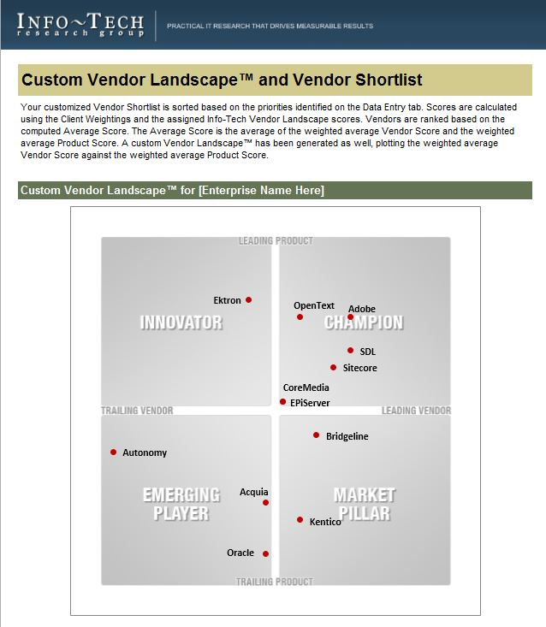
Identify leading candidates with the Web Experience Management Vendor Shortlist Tool
The Info-Tech Web Experience Management Vendor Shortlist Tool is designed to generate a customized shortlist of vendors based on your key priorities.
This tool offers the ability to modify:
Overall Vendor vs. Product Weightings
Individual product criteria weightings:
Features
Usability
Affordability
Architecture
Individual vendor criteria weightings:
Viability
Strategy
Reach
Channel

Slide 9
Appendix
Vendor Landscape Methodology: Overview
Vendor Landscape Methodology: Product Selection & Information Gathering
Vendor Landscape Methodology: Scoring
Vendor Landscape Methodology: Information Presentation
Vendor Landscape Methodology: Fact Check & Publication
Product Pricing Scenario

Slide 10
Vendor Landscape Methodology:
Overview
Info-Tech’s Vendor Landscapes are research materials that review a particular IT market space, evaluating the strengths and abilities of both the products available in that space, as well as the vendors of those products. These materials are created by a team of dedicated analysts operating under the direction of a senior subject matter expert over a period of six weeks.
Evaluations weigh selected vendors and their products (collectively “solutions”) on the following eight criteria to determine overall standing:
Features: The presence of advanced and market-differentiating capabilities.
Usability: The intuitiveness, power, and integrated nature of administrative consoles and client software components.
Affordability: The three-year total cost of ownership of the solution.
Architecture: The degree of integration with the vendor’s other tools, flexibility of deployment, and breadth of platform applicability.
Viability: The stability of the company as measured by its history in the market, the size of its client base, and its financial performance.
Strategy: The commitment to both the market-space, as well as to the various sized clients (small, mid-sized, and enterprise clients).
Reach: The ability of the vendor to support its products on a global scale.
Channel: The measure of the size of the vendor’s channel partner program, as well as any channel strengthening strategies.
Evaluated solutions are plotted on a standard two by two matrix:
Champions: Both the product and the vendor receive scores that are above the average score for the evaluated group.
Innovators: The product receives a score that is above the average score for the evaluated group, but the vendor receives a score that is below the average score for the evaluated group.
Market Pillars: The product receives a score that is below the average score for the evaluated group, but the vendor receives a score that is above the average score for the evaluated group.
Emerging Players: Both the product and the vendor receive scores that are below the average score for the evaluated group.
Info-Tech’s Vendor Landscapes are researched and produced according to a strictly adhered to process that includes the following steps:
Vendor/product selection
Information gathering
Vendor/product scoring
Information presentation
Fact checking
Publication
This document outlines how each of these steps is conducted.

Slide 11
Vendor Landscape Methodology:
Vendor/Product Selection & Information Gathering
Info-Tech works closely with its client base to solicit guidance in terms of understanding the vendors with whom clients wish to work and the products that they wish evaluated; this demand pool forms the basis of the vendor selection process for Vendor Landscapes. Balancing this demand, Info-Tech also relies upon the deep subject matter expertise and market awareness of its Senior, Lead, and Principle Research Analysts to ensure that appropriate solutions are included in the evaluation. As an aspect of that expertise and awareness, Info-Tech’s analysts may, at their discretion, determine the specific capabilities that are required of the products under evaluation, and include in the Vendor Landscape only those solutions that meet all specified requirements.
Information on vendors and products is gathered in a number of ways via a number of channels.
Initially, a request package is submitted to vendors to solicit information on a broad range of topics. The request package includes:
A detailed survey.
A pricing scenario (see Vendor Landscape Methodology: Price Evaluation and Pricing Scenario, below).
A request for reference clients.
A request for a briefing and, where applicable, guided product demonstration.
These request packages are distributed approximately twelve weeks prior to the initiation of the actual research project to allow vendors ample time to consolidate the required information and schedule appropriate resources.
During the course of the research project, briefings and demonstrations are scheduled (generally for one hour each session, though more time is scheduled as required) to allow the analyst team to discuss the information provided in the survey, validate vendor claims, and gain direct exposure to the evaluated products. Additionally, an end-user survey is circulated to Info-Tech’s client base and vendor-supplied reference accounts are interviewed to solicit their feedback on their experiences with the evaluated solutions and with the vendors of those solutions.
These materials are supplemented by a thorough review of all product briefs, technical manuals, and publicly available marketing materials about the product, as well as about the vendor itself.
Refusal by a vendor to supply completed surveys or submit to participation in briefings and demonstrations does not eliminate a vendor from inclusion in the evaluation. Where analyst and client input has determined that a vendor belongs in a particular evaluation, it will be evaluated as best as possible based on publicly available materials only. As these materials are not as comprehensive as a survey, briefing, and demonstration, the possibility exists that the evaluation may not be as thorough or accurate. Since Info-Tech includes vendors regardless of vendor participation, it is always in the vendor’s best interest to participate fully.
All information is recorded and catalogued, as required, to facilitate scoring and for future reference.

Slide 12


Info-Tech Research Group Helps IT Professionals To:
Quickly get up to speed
with new technologies
Make the right technology
purchasing decisions – fast
Deliver critical IT
projects, on time and
within budget
Manage business expectations
Justify IT spending and
prove the value of IT
Train IT staff and effectively
manage an IT department
Sign up for free trial membership to get practical
solutions for your IT challenges
“Info-Tech helps me to be proactive instead of reactive –
a cardinal rule in a stable and leading edge IT environment.
  - ARCS Commercial Mortgage Co., LP
Toll Free: 1-888-670-8889
www.infotech.com

