Slide 1

Vendor Landscape: Converged Systems
Come together... Right now... Over a pool of compute, storage, and networking resources.
Info-Tech's products and services combine actionable insight and relevant advice with ready-to-use tools
and templates that cover the full spectrum of IT concerns.© 1997 - 2013 Info-Tech Research Group

Slide 2
Introduction
Proven in the large enterprise, converged systems have moved downmarket as a means of consolidating resources and increasing operational flexibility.
This Research Is Designed For:
This Research Will Help You:
Medium to large enterprises or service providers looking to purchase a converged system.
Their converged systems use case may include:
  Pooling storage, compute, and networking resources to reduce server sprawl.
  Automating common storage tasks and streamlining maintenance.
  Building the foundation for a private or public cloud.
Understand what’s new in the converged systems market.
Evaluate converged systems vendors and products for your enterprise needs.
Determine which products are most appropriate for particular use cases and scenarios.

Slide 3

Market Overview
How it got here
Where it’s going
Blades were originally used for high-performance computing, but evolved to become a solid virtualization and consolidation technology with strong market growth.
In 2009 Cisco changed the market with its introduction of the Unified Computing System (UCS), a product that combined blades and networking technology. Traditional blade market leaders like HP, IBM, and Dell responded with their own combined blade and networking products. The most notable was HP with its Blade System Matrix.
In 2009, VMware, Cisco, and EMC started VCE, a joint venture to deliver converged systems including virtualization software, servers, networking, and storage. VCE went to market with its Vblock pre-integrated systems starting in 2010.
In the last 18 months, many of the major server and storage vendors have developed their own pre-integrated converged infrastructure solutions. This includes HP’s Converged Systems, IBM’s PureSystems, and Dell’s Active Infrastructures products.
Cisco has continued to invest in partnerships with vendors beyond EMC/VMware to create reference architectures that simplify support and implementation for non-EMC customers. Notably, Cisco has partnered with top storage provider NetApp to deliver the FlexPod series of reference architectures that combine NetApp FAS systems with Cisco UCS.
Going forward, converged systems vendors will be challenged to continue innovating and differentiating in an ecosystem where components are increasingly standardized and commoditized. Management software for these converged solutions will be a key area to watch for innovation.
As the market evolves, options that were once cutting edge become default and new products become differentiating. Integrated blade servers/networking is now a widely available option and it should no longer be used to differentiate solutions. Instead focus on solutions that can effectively integrate storage into the mix to simplify system implementation and management.

Slide 4
Converged systems vendor selection / knock-out criteria: market share, mind share, and stack management software
For this Vendor Landscape, Info-Tech focused on those vendors that offer stack management software with their converged solutions, and that have a strong market presence and/or reputational presence among mid and large-sized enterprises.
Included in this Vendor Landscape:
Cisco-NetApp. A recent partnership between two market movers to deliver jointly developed reference architectures.
Dell. A major player with a reputation for ease of use and strong support offerings.
Fujitsu. With a strong following outside of North America, Fujitsu offers a variety of converged systems products.
Hitachi. A new entrant in the converged systems market, with a strong mainframe heritage.
HP. An industry leader in the blade market and an early pioneer of converged systems.
IBM. A veteran blade manufacturer. Its converged systems line, PureSystems, is a relatively recent development.
Oracle. A niche player in the converged market. Ideal for organizations already working in an Oracle environment.
VCE. A joint venture of VMware, Cisco, and EMC offering a tightly integrated solution built from leading components.

Slide 5
Converged systems criteria & weighting factors
Product Evaluation Criteria
Criteria Weighting:
Criteria Weighting:
Features
The solution provides basic and advanced feature/functionality.
Usability
Features
Usability
Dashboard and reporting tools are intuitive and easy to use. The solution is easy to implement.
Affordability
The three year TCO of the solution is economical.
Affordability
Architecture
Architecture
The delivery method of the solution aligns with what is expected within the space.
Product
Vendor Evaluation Criteria
Viability
Vendor is profitable, knowledgeable, and will be around for the long-term.
Strategy
Vendor is committed to the space and has a future product and portfolio roadmap.
Vendor
Viability
Reach
Vendor offers global coverage and is able to sell and provide post-sales support.
Strategy
Channel
Vendor channel strategy is appropriate and the channels themselves are strong.
Channel
Reach

Slide 6
Table Stakes represent the minimum standard; without these, a product doesn’t even get reviewed
The Table Stakes
What Does This Mean?
Feature
What it is:
The products assessed in this Vendor LandscapeTM meet, at the very least, the requirements outlined as Table Stakes.
Many of the vendors go above and beyond the outlined Table Stakes, some even do so in multiple categories. This section aims to highlight the products’ capabilities in excess of the criteria listed here.
Infrastructure convergence
Networking, servers, storage, and management software are packaged into a single, optimized computing solution.
Hardware failover & redundancy
Total redundancy and failover for all management modules, network, disk, and power connections.
Processing capability
Supports Intel Xeon or AMD Opteron processors.
Hot-swappable capabilities
Blades can be removed and replaced without powering down chassis/enclosures.
Fiber Channel over 10GB Ethernet
The converged stack supports Fiber Channel over 10GB Ethernet.
Reporting
The solution includes monitoring and reporting capabilities to facilitate capacity management, planning, and drill down to investigate failures.
If Table Stakes are all you need from your converged systems solution, the only true differentiator for the organization is price. Otherwise, dig deeper to find the best price to value for your needs.

Slide 7
Advanced Features are the capabilities that allow for granular market differentiation
Scoring Methodology
Advanced Features
Info-Tech scored each vendor’s features offering as a summation of their individual scores across the listed advanced features. Vendors were given one point for each feature the product inherently provided. Some categories were scored on a more granular scale with vendors receiving half points.
Feature
What we looked for:
Layer ownership
Vendor owns all layers of the converged stack including server, network, and storage.
Switch options
Solutions offer the option to choose between more than one brand of switch.
Pre-integrated option
Vendor offers a pre-integrated converged solution.
Reference architectures
Vendor offers pre-validated reference architecture options as part of their converged portfolio.
Form-factor options
Vendor offers options in both blade and rack-mount configurations.
Multi-hypervisor pre-integration
Offers choice of hypervisors pre-integrated or pre-validated (if no pre-integrated solutions exist).
APIs/SDKs for integration
Vendor offers strong APIs and/or a SDK for integration with management/monitoring software.
Unified management
One fully-featured UI for management/provisioning of servers, network, and storage.
Centralized patch handling
All system updates are handled from one interface.
Options for non-x86 architecture
UNIX/RISC/other systems are available.
For an explanation of how Advanced Features are determined, see Information Presentation – Feature Ranks (Stop Lights) in the Appendix.

Slide 8
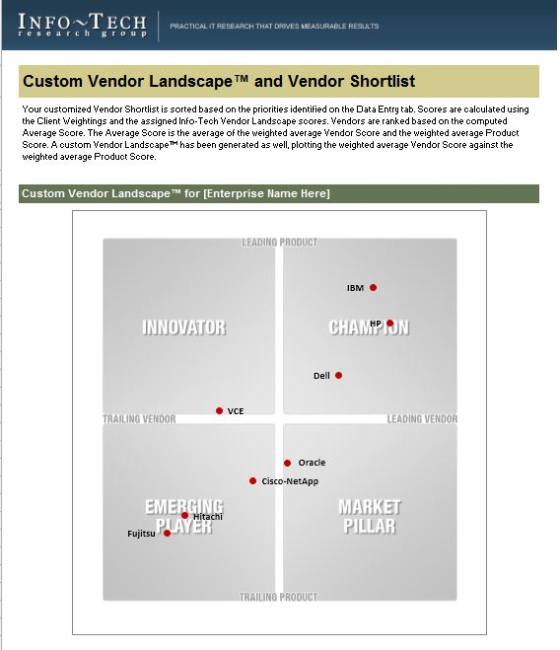
Identify leading candidates with the Converged Systems Vendor Shortlist Tool
The Info-Tech Converged Systems Vendor Shortlist Tool is designed to generate a customized shortlist of vendors based on your key priorities.
This tool offers the ability to modify:
Overall Vendor vs. Product Weightings
Individual product criteria weightings:
Features
Usability
Affordability
Architecture
Individual vendor criteria weightings:
Viability
Strategy
Reach
Channel

Slide 9
Appendix
Vendor Landscape Methodology: Overview
Vendor Landscape Methodology: Product Selection & Information Gathering
Vendor Landscape Methodology: Scoring
Vendor Landscape Methodology: Information Presentation
Vendor Landscape Methodology: Fact Check & Publication
Product Pricing Scenario

Slide 10
Vendor Landscape Methodology:
Overview
Info-Tech’s Vendor Landscapes are research materials that review a particular IT market space, evaluating the strengths and abilities of both the products available in that space, as well as the vendors of those products. These materials are created by a team of dedicated analysts operating under the direction of a senior subject matter expert over a period of six weeks.
Evaluations weigh selected vendors and their products (collectively “solutions”) on the following eight criteria to determine overall standing:
Features: The presence of advanced and market-differentiating capabilities.
Usability: The intuitiveness, power, and integrated nature of administrative consoles and client software components.
Affordability: The three-year total cost of ownership of the solution.
Architecture: The degree of integration with the vendor’s other tools, flexibility of deployment, and breadth of platform applicability.
Viability: The stability of the company as measured by its history in the market, the size of its client base, and its financial performance.
Strategy: The commitment to both the market-space, as well as to the various sized clients (small, mid-sized, and enterprise clients).
Reach: The ability of the vendor to support its products on a global scale.
Channel: The measure of the size of the vendor’s channel partner program, as well as any channel strengthening strategies.
Evaluated solutions are plotted on a standard two by two matrix:
Champions: Both the product and the vendor receive scores that are above the average score for the evaluated group.
Innovators: The product receives a score that is above the average score for the evaluated group, but the vendor receives a score that is below the average score for the evaluated group.
Market Pillars: The product receives a score that is below the average score for the evaluated group, but the vendor receives a score that is above the average score for the evaluated group.
Emerging Players: Both the product and the vendor receive scores that are below the average score for the evaluated group.
Info-Tech’s Vendor Landscapes are researched and produced according to a strictly adhered to process that includes the following steps:
Vendor/product selection
Information gathering
Vendor/product scoring
Information presentation
Fact checking
Publication
This document outlines how each of these steps is conducted.

Slide 11
Vendor Landscape Methodology:
Vendor/Product Selection & Information Gathering
Info-Tech works closely with its client base to solicit guidance in terms of understanding the vendors with whom clients wish to work and the products that they wish evaluated; this demand pool forms the basis of the vendor selection process for Vendor Landscapes. Balancing this demand, Info-Tech also relies upon the deep subject matter expertise and market awareness of its Senior, Lead, and Principle Consulting Analysts to ensure that appropriate solutions are included in the evaluation. As an aspect of that expertise and awareness, Info-Tech’s analysts may, at their discretion, determine the specific capabilities that are required of the products under evaluation, and include in the Vendor Landscape only those solutions that meet all specified requirements.
Information on vendors and products is gathered in a number of ways via a number of channels.
Initially, a request package is submitted to vendors to solicit information on a broad range of topics. The request package includes:
A detailed survey.
A pricing scenario (see Vendor Landscape Methodology: Price Evaluation and Pricing Scenario, below).
A request for reference clients.
A request for a briefing and, where applicable, guided product demonstration.
These request packages are distributed approximately twelve weeks prior to the initiation of the actual research project to allow vendors ample time to consolidate the required information and schedule appropriate resources.
During the course of the research project, briefings and demonstrations are scheduled (generally for one hour each session, though more time is scheduled as required) to allow the analyst team to discuss the information provided in the survey, validate vendor claims, and gain direct exposure to the evaluated products. Additionally, an end-user survey is circulated to Info-Tech’s client base and vendor-supplied reference accounts are interviewed to solicit their feedback on their experiences with the evaluated solutions and with the vendors of those solutions.
These materials are supplemented by a thorough review of all product briefs, technical manuals, and publicly available marketing materials about the product, as well as about the vendor itself.
Refusal by a vendor to supply completed surveys or submit to participation in briefings and demonstrations does not eliminate a vendor from inclusion in the evaluation. Where analyst and client input has determined that a vendor belongs in a particular evaluation, it will be evaluated as best as possible based on publicly available materials only. As these materials are not as comprehensive as a survey, briefing, and demonstration, the possibility exists that the evaluation may not be as thorough or accurate. Since Info-Tech includes vendors regardless of vendor participation, it is always in the vendor’s best interest to participate fully.
All information is recorded and catalogued, as required, to facilitate scoring and for future reference.

Slide 12
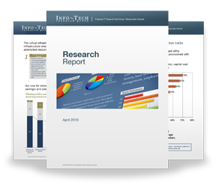

Info-Tech Research Group Helps IT Professionals To:
Quickly get up to speed
with new technologies
Make the right technology
purchasing decisions – fast
Deliver critical IT
projects, on time and
within budget
Manage business expectations
Justify IT spending and
prove the value of IT
Train IT staff and effectively
manage an IT department
Sign up for free trial membership to get practical
solutions for your IT challenges
“Info-Tech helps me to be proactive instead of reactive –
a cardinal rule in a stable and leading edge IT environment.
  - ARCS Commercial Mortgage Co., LP
Toll Free: 1-888-670-8889
www.infotech.com

