Slide 1

Develop a SharePoint Governance Strategy
Bring a Sheriff to the SharePoint Wild West
Info-Tech's products and services combine actionable insight and relevant advice with ready-to-use tools
and templates that cover the full spectrum of IT concerns.© 1997 - 2012 Info-Tech Research Group

Slide 2
Introduction
Use this research to get a handle on what needs to be governed and how to achieve operational success.
This Research Is Designed For:
This Research Will Help You:
CIOs and IT managers who have already made the decision to deploy, or have deployed, SharePoint.
Deployments with moderate complexity and informal processes.
Enterprises and SharePoint deployments of all sizes.
Understand what SharePoint elements require governance.
Create a SharePoint governance model and plan.
Govern SharePoint on an on-going basis.
Regardless of version deployed, enterprises are finding out the hard way that SharePoint won’t govern itself. Without sufficient planning, SharePoint is often used recklessly if at all. Consult Info-Tech’s “Select the Right Collaboration Platform” and “Evaluate SharePoint for ECM” for help with SharePoint evaluation. For SharePoint Development see “Manage a SharePoint Customization & Development Team”.

Slide 3
Executive Summary
An ungoverned SharePoint threatens more than business requirements– it can bring your business to a grinding halt.
Understand
Strategize
Manage
SharePoint should never be deployed without planning or governance considerations.
SharePoint will become a mission critical application, with or without you. If you’re not prepared, failure is not an unlikely outcome.
Governing SharePoint is not just throwing a team together or rehashing old policies. Design and configuration of SharePoint is a key responsibility for modern IT Business Analysts.
Develop a strategy around architecture, security, maintenance, storage planning, development, and policies; the sooner the better. Ideally this should be well before deployment, but can still be done years later if necessary.
Don’t let additional governance needs deter you from using SharePoint 2010; with more requirements comes more governance functionality.
Involving business stakeholders has the largest impact on operational success.
SharePoint can be effectively governed by having a few basic processes, policies, and standards in place.
Training will make or break your SharePoint deployment.
Effective governance goes beyond design and can mitigate the risk of operational issues.

Slide 4

Understand
Govern or fail: the choice is yours.
SharePoint success is a factor of use cases, so govern accordingly.
Set up SharePoint like a content database, not a fileserver.
Follow Info-Tech’s SharePoint Governance Model to cover all the bases.
Understand
Strategize
Formalize
Manage

Slide 5
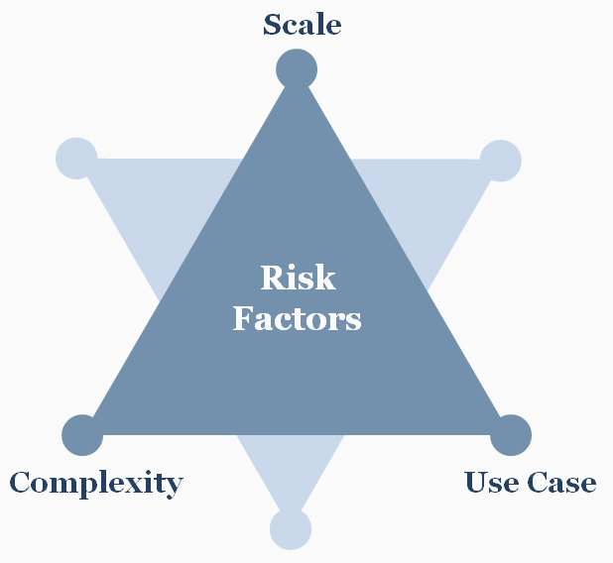

Everyone needs governance, but some factors create additional risk
Scale, complexity, and use cases all complicate SharePoint initiatives and significantly increase the risk of disaster if left ungoverned.
Scale
More than 250 users use SharePoint.
More than 2 instances of SharePoint are deployed.
Complexity
SharePoint is being used across multiple geographic offices or across countries.
The Enterprise is subject to regulatory requirements.
User permissions need to be set up below the department level.
Use Case
SharePoint will be used for more than 3 unique use cases (e.g. intranet, collaboration, ECM).
SharePoint will be used for ECM, records management or as an extranet portal.
Using SharePoint for small, simple initiatives isn’t a free pass. Keep an eye on changing business requirements and use profiles so you’re ready when your risk profile increases.

Slide 6
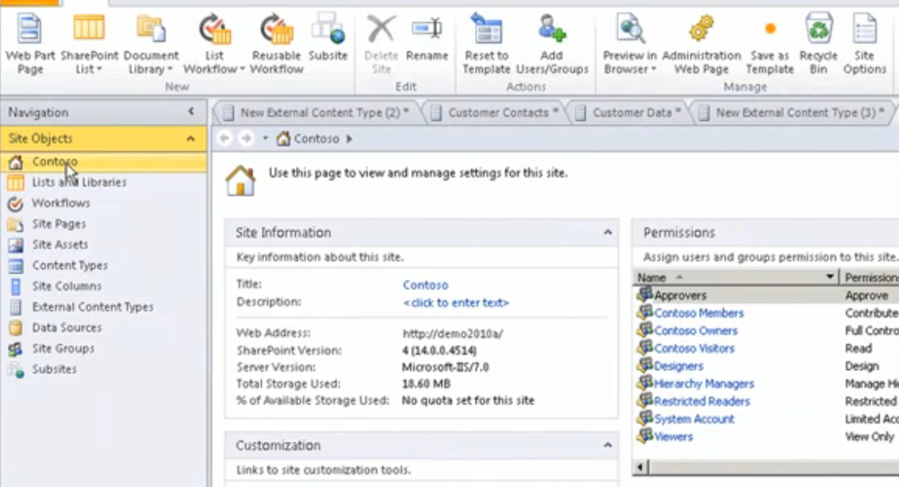
Using SharePoint as an Extranet requires additional design and security considerations
Extranets are trouble. If you’ll be using one, allocate additional time and resources to the planning and setup, and expect high levels of difficulty.
Collaboration with external partners is often extremely beneficial, but confidentiality management beyond the firewall is tough.
Login-based portal access is ideal for access control so only the right external users can see the content.
With sensitive data, additional business planning around compliance is recommended.
Operating an intranet and extranet instance of SharePoint requires additional considerations:
How will you connect the two platforms/portals together, and how will you connect it with partner platforms outside the enterprise?
Anticipate document management issues, e.g. how will you deal with multiple copies of the same document inside and outside the organization
Determine whether the intranet will be used for the extranet and whether its design will mirror the enterprise’s other public-facing content.
Enterprises using extranets were more than twice as likely to require custom development.
Customized, Deployed Extranet
53%
23%
Customized, Didn’t Deploy Extranet
N = 47; Source: Info-Tech Research Group

Slide 7
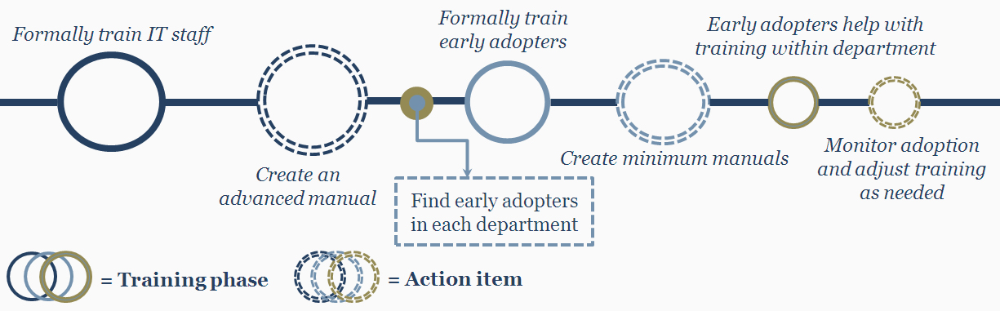
Training will make or break your SharePoint deployment
Take a formal approach to ensure end-user adoption.
A run book; include network configurations, reboot procedures, monthly/daily maintenance, and troubleshooting guidelines.
Have one copy in IT.
Advanced Manual
An employee in a department quick to adopt new technologies and processes.
Usually someone who has recently joined the company and has not developed habitual methods of doing things.
Early Adopters
A step-by-step description of the tasks to be performed by a department; include screen shots, written descriptions, and an index.
Have one per department, tailored to that department.
Minimum Manuals

Slide 8
Summary
To succeed, every SharePoint initiative requires a strategy around architecture, security, maintenance, storage planning, development, and policies.
There is no scenario in which SharePoint should be deployed without planning or governance considerations.
SharePoint very quickly becomes a mission critical application, with or without you. If you’re not prepared, disaster is only a matter of time.
Governing SharePoint is not just throwing a team together or rehashing old policies. It is a procedure and a business analyst job function, not a one-time project.
The sooner you can develop a strategy around each element, the better.
Don’t let additional governance needs deter you from using SharePoint 2010; with more requirements comes more included governance functionality.
Designing an appropriate information architecture is your most important task and cannot be overlooked.
Every SharePoint user’s permissions must be considered and set up.
Assign responsibility for SharePoint maintenance or it won’t get done.

Slide 9
Appendix
Administration and Security
Integration
Features
Tools
SharePoint Server Application Integration
Recommendations

Slide 10
Administration and Security
Sandbox development environment
Site-level workflows for complex business scenarios
Advanced PowerShell scripting capabilities
New logging Object Model for server use analytics

Slide 11
Recommendations
Factor in the server costs – hardware and software. SharePoint 2010 requires 64-bit servers running 64-bit Windows Server 2008 and SQL Server. If upgrading, schedule the implementation to coincide with planned server upgrades.
Windows Server 2008 64-bit users should try SharePoint Foundation. Enterprises running Windows Server 2008 64-bit should take advantage of SharePoint Foundation 2010 when it is officially released, since the license will be included with the server software.
Use SharePoint 2010 as a collaboration and content solution. In the past, organizations had to look at add-ons, like Jive and Telligent , for advanced collaboration features that could be added onto their existing SharePoint content repository.

Slide 12
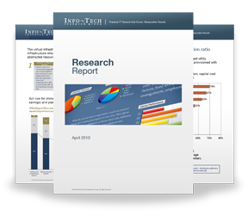

Info-Tech Research Group Helps IT Professionals To:
Quickly get up to speed
with new technologies
Make the right technology
purchasing decisions – fast
Deliver critical IT
projects, on time and
within budget
Manage business expectations
Justify IT spending and
prove the value of IT
Train IT staff and effectively
manage an IT department
Sign up for free trial membership to get practical
solutions for your IT challenges
“Info-Tech helps me to be proactive instead of reactive –
a cardinal rule in a stable and leading edge IT environment.
  - ARCS Commercial Mortgage Co., LP
Toll Free: 1-888-670-8889
www.infotech.com

