Slide 1

Transition to BYOD… and Beyond
Adapt to BYOD and help future-proof your organization for BYOE
Info-Tech's products and services combine actionable insight and relevant advice with ready-to-use tools
and templates that cover the full spectrum of IT concerns.© 1997 - 2012 Info-Tech Research Group

Slide 2
Introduction
BYOD is here to stay, but the transition can’t happen overnight. Make a cost-conscious shift to BYOD that will be effective for years to come.
This Research Is Designed For:
This Research Will Help You:
IT professionals at any organization. Bring your own device (BYOD) is affecting every IT department, whether they have opted in or not.
Organizational leaders and stakeholders. Top-level employees at almost every organization have been confronted by BYOD.
Make the transition to BYOD from the traditional corporate-issued device approach.
Begin preparing for Bring Your Own Everything (BYOE) with a device-agnostic approach.
Engage key stakeholders in the implementation of BYOD programming.
This Research Will Not Help You:
Deal with “BYOA” (Bring Your Own Apps) or with personal cloud services.

Slide 3
Ask: Am I reading the right material?
Take a look at Info-Tech’s other solution sets to understand BYOD in the context of important trends like mobility and consumerization.
Develop a Mobile Management Strategy
Vendor Landscape: Mobile Device Management Suites
A
You are here:
Transition to BYOD … and Beyond
Understand and Manage Consumerization
BYOD
Tackle the Technology of Consumerization
Consumerization
Mobility

Slide 4


Adapt to a BYOD World to Prepare for BYOE
The reality of BYOD: support is no longer a choice.
The importance of developing a strategy that looks beyond current devices to prepare for BYOE.
The infrastructure options for supporting a device-agnostic workplace.
The advantages that a strong BYOD strategy can bring.
Adapt to a BYOD World to Prepare for BYOE
Transition to BYOD
Maintain Security and Control
Walk the Fine Line Between Corporate and Private
Cost-Effectively Transition
Prepare IT for BYOD and Beyond

Slide 5
Focus on how to manage BYOD, not if you should manage it
The sooner your organization adapts, the sooner it can go from merely avoiding risk to taking full advantage of the benefits of BYOD.
The majority of organizations explicitly allow use of personal devices for work purposes
Nearly 90% of organizations allow access to corporate email on personal mobile devices
Almost all organizations have personal smartphones in the workplace
55.9%
88.9%
97%
N = 127+. Source: Info-Tech Research Group.
Personal devices are in almost every workplace, whether they are officially supported or not.
The rise of BYOD does not necessarily bring cost savings or any other benefits. However, the cost of ignoring the influx of personal devices is far higher than having a strategy that aims to leverage the benefits of BYOD. Ultimately, a strategy will save time and money while making end users happier and more productive.
Cost-effectively transition to supporting BYOD. Improvements in user experience and productivity will be immediate. Making the transition will also prepare you for a BYOE (Bring Your Own Everything) future.
“Resistance to embracing BYOD due to perceived lack of control is a flawed position. People will find a way to use their preferred devices regardless of the policies in place.”
— IT Manager,
Fitness Club Chain
Resistance to BYOD is futile, and indifference may actually increase risks. With a sound management strategy, IT can begin welcoming employees to BYOD.

Slide 6
Acknowledge concerns and risks, but most must transition to BYOD
Address the Top Concerns…
…But Don’t Worry if You’re Worried
Pearson correlation r = .21, N = 128, p = .02.
Source: Info-Tech Research Group.
N = 128. Source: Info-Tech Research Group.
Concerns with BYOD
(1 = Low concern, 6 = High concern)
Correlation of BYOD Success and Overall Concern
(Line of Best Fit)
IT professionals who express the most concern with BYOD issues (left) also tend to be the most successful.
Success factors include employee satisfaction and productivity, protection of personal info, compliance, security, and management.
Channel concern with BYOD into successful strategy.
Top concerns with BYOD include security and control issues, separation of personal data from corporate data, and difficulty transitioning from corporate-issued devices.
The following sections will address these concerns and provide advice for how to transition to BYOD while mitigating the risks that it brings.

Slide 7
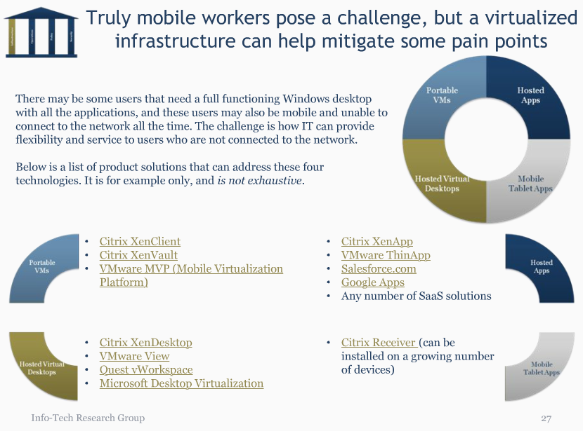
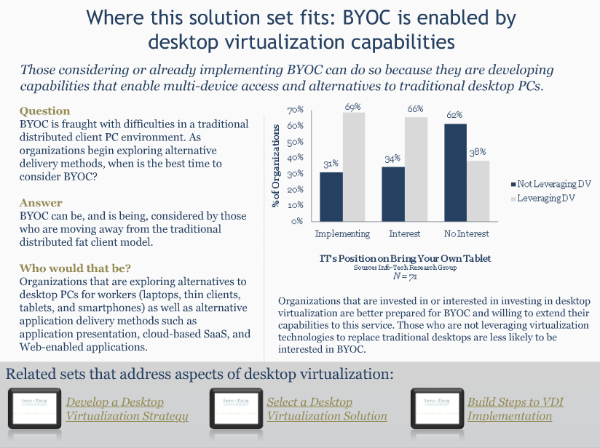

The line between BYOD and BYOC is being obliterated
Bringing your own laptop to work (e.g., Bring Your Own Computer, or BYOC) used to be unheard of.
After getting accustomed to bringing mobile devices to work, and with computers becoming more powerful and portable (especially so-called ultrabooks), bringing your own computer seems like a logical choice.
Macs, in particular, are finding their way into the previously Windows-dominated enterprise.
A full-fledged and unfamiliar computer invading an organization may seem like a nightmare to IT, but technology and culture are advancing to the point where it may be viable to support, and most organizations will be faced with it whether they like it or not.
BYOD commonly refers to mobile devices, but is expanding to refer to a wide range of devices, including traditional computers. It is time to unify your strategy for BYOD with BYOC.
Consult the Info-Tech solution set Consider BYOC as Part of a Desktop-as-a-Service Strategy for more background information on BYOC/D, objectives, strategy considerations, and communicating a BYO plan. This set assumes you have decided to deal with BYOD, and will give you advice on how to transition to BYOD securely and cost-effectively.
Is it a post-PC world? Whether the PC is evolving or being replaced is irrelevant. There will be a move away from traditional laptops as primary work devices, but this shift has not happened yet. The BYOD revolution transcends form factor, which means that laptops will require support until the post-PC world has fully arrived. Strategize for both PCs and post-PC devices, so you will be prepared for whatever letter comes after “BYO.”

Slide 8
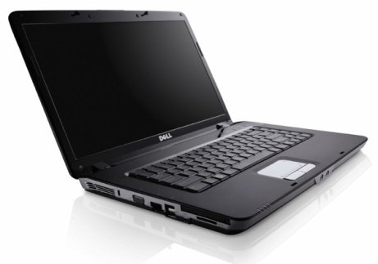
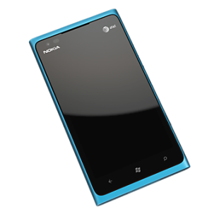
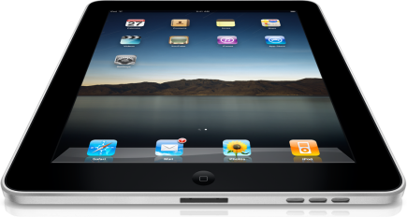


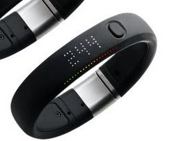
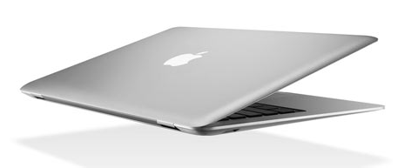
Strategize for a full range of “D”s
Reinvigorate workforce computing by developing a strategy that incorporates all the devices users can—and will—bring to the workplace.
BYOD started with smartphones, which subsequently opened the door for employees to bring all their devices to the workplace. Any portable device can be brought to the workplace, whether nomadic or completely mobile (see below).
People are more into technology than ever before. Even luddites are finding technology creeping in to every aspect of their lives. As devices become part of everyday life for every person, there will be increasing demand to support that technology in the workplace.
Technology changes quickly. A BYOD strategy aimed at a particular form factor or platform will quickly become outdated. Don’t limit your BYOD strategy to one type of device.
Nomadic
Mobile
Beyond
Nomadic devices are portable, but carried between and used at a limited number of destinations (e.g., work).
Tablets are generally nomadic, but are small enough to be used between destinations in addition to being brought to work.
Truly mobile devices are carried at all times and used wherever they are needed. Users don’t stop using them when they get to work.
Future form factors will make computing even more ubiquitous. A strong BYOD strategy will be ready for any device.

Slide 9
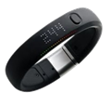
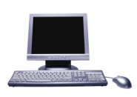
Remain device agnostic to prepare for a BYOE future
Investing in BYOD today will ensure you’re ready for BYOE tomorrow.
“It’s not about the devices anymore and if you’re convinced it is, you are eventually going to fail. [Change your strategy] from delivering devices to delivering information to the people who need it, anytime, anywhere, on any usable device.”
— Brian Katz,
Head of Mobility Engineering, on The Enterprise Mobility Forum Blog
Proportion of Devices Used for Work, by Device Type
100%
Smartphones
Tablets
Future Devices
Personal Cloud
PCs
50%
BYOD is leading into BYOE: Bring Your Own Everything. With technology becoming intertwined with every person’s life, a wide variety of gadgets will need to be acknowledged by organizations’ IT departments or they will fall behind.
Support BYOD today with an eye to the future. Becoming device agnostic—e.g., delivering data and services that can be accessed from any device—is the end goal that will prepare you for a BYOE world.
Luckily, many of the technologies and policies that support today’s BYOD reality will also prepare you for tomorrow’s possibilities.
0%
Past
Present
Future
Today, most work is done on traditional PCs, but that is changing quickly. Support the small percentage of personal post-PC devices like smartphones and tablets to prepare for a future in which they become primary tools in workforce computing.

Slide 10
Consider virtual desktops to help achieve device agnosticism
Personally owned
Corporate owned
Corporate resource
Virtual machine
Corporate network
Info-Tech Insight
Virtualization is a short-term solution. Although it technically enables BYOD, many of the advantages of a personal device are erased if users are forced to use a virtual machine that may or may not be tailored to the device’s form factor, and is isolated from the rest of the device. It may be good enough for today, especially if VDI is already in place.
The traditional model has IT lock down every device so that it is trustworthy enough to enter the corporate network and access resources. It is not easily device agnostic because IT needs access to every device.
A virtual desktop model sets up virtual machines within the network with access to resources. Devices act as thin clients with access to the pixels pushed by the virtual machines.
Local virtual machines run on the user’s device, and are allowed access to the network. Both virtual machine methods are generally device agnostic as long as running or accessing virtual machines is possible on the device.

Slide 11
Cloud and agent-based approaches can also enable device agnosticism; implement the right approach for the job
BYOD Often Benefits from a Mixed Approach
No single approach is perfect. Virtualization offers maximum control, but a lesser user experience, especially on mobile devices. The cloud approach can offer control and user experience, but developing device agnostic cloud applications is expensive. An agent-based approach offers good user experience, but can introduce security holes.
Begin with a mixed approach. Most organizations already employ some of these methods. Adapt them to support personal devices, with different approaches for different devices and applications.
For example:
  If virtual desktops are already in place to support teleworkers, ensure the same infrastructure can be used to provide access to personal tablets.
  Use existing cloud services, such as Salesforce.com, which are already largely device-agnostic.
  Use an agent-based MDM solution for smartphones.
User experience is key. For each device type and application, weigh risk against user experience. Advantages of BYOD can be erased if users can’t use their devices the way they want to due to increased control.
A cloud model has users authenticate with each resource, as is done with cloud services. Resources can be accessed by any device through an application-specific client or through a web browser.
An agent-based approach installs an agent on a device that vets it to ensure it is allowed to connect to resources based on IT’s criteria (e.g., OS is up to date). This is the approach of mobile device management.

Slide 12
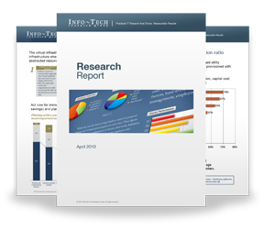

Info-Tech Research Group Helps IT Professionals To:
Quickly get up to speed
with new technologies
Make the right technology
purchasing decisions – fast
Deliver critical IT
projects, on time and
within budget
Manage business expectations
Justify IT spending and
prove the value of IT
Train IT staff and effectively
manage an IT department
Sign up for free trial membership to get practical
solutions for your IT challenges
“Info-Tech helps me to be proactive instead of reactive –
a cardinal rule in a stable and leading edge IT environment.
  - ARCS Commercial Mortgage Co., LP
Toll Free: 1-888-670-8889
www.infotech.com

