Slide 1

Bridge the Gap between Service Management and Disaster Recovery
Treating DR as a separate entity outside of normal IT operations leaves organizations vulnerable to less-dramatic — but far more common — causes of extended service interruptions.

Slide 2
Introduction
Disasters need to be viewed on a continuum — from isolated service interruptions (e.g. disk failure) to “the building’s on fire” — and an appropriate continuum of responses needs to be in place. To that end, disaster recover (DR) is best managed as an extension of service management.
This Research Is Designed For:
This Research Will Help You:
Organizations struggling to meet recovery time objectives, or that lack confidence in their disaster recovery plan (DRP).
Senior IT management responsible for disaster recovery.
Service management leaders looking to bridge the gap between their processes and the DRP.
Understand the relationship and workflow between service management and DR.
Perform a business impact analysis (BIA) to establish Recovery Point Objectives (RPOs) and Recovery Time Objectives (RTOs).
Perform a risk assessment to identify where you need to prioritize investments.
Extend service management processes to account for DR scenarios.
A large percentage of disaster scenarios are due to internal issues, including hardware and software failures.
– Michael Gordon, Group IT Projects Manager, PMP (NZ) Limited
Major disasters are damaging, but rare. Smaller internal disasters are more common and can be just as damaging.
                – Ken Lauder, MIS Manager, Tucker Rocky Distributing

Slide 3
Executive Summary
Software and hardware failures account for 45% of unacceptable downtime, compared to only 17% due to major events, such as fires and natural disasters, based on an Info-Tech survey (n=87).
However, DRPs typically focus on major events. For less obvious DR scenarios , it’s often unclear when DR procedures need to take over. For example, IT leaders can fall victim to the “IT hero” and the familiar refrain of “I just need five more minutes,” or maintenance crews promising that it should only take a couple hours to restore power or network connectivity, and wait too long to initiate DR procedures.
Incorporating DR scenarios into service management processes leads to better decisions about how to respond to less obvious DR scenarios, when to escalate those incidents, and whether to initiate recovery procedures rather than continue troubleshooting.
This report will walk you through:
  How service management processes can help you meet your Recovery Point Objectives (RPOs) and Recovery Time Objectives (RTOs).
  Performing a business impact analysis to establish system criticality and recovery objectives.
  Extending service manage processes to account for disaster scenarios, and to reflect different levels of system criticality as identified by the business impact analysis.
We find that our clients who have a higher level of IT maturity understand the relationship between service management and DR; they understand when an incident needs to be escalated and treated as a potential DR scenario. Others with less IT maturity struggle with this.
– Terry Rennaker, VP and Director of Infrastructure, Skanska

Slide 4

Why DRPs fail, and how the solution starts with service management
DRPs tend to focus on major disasters
Account for disasters in your service management processes
Define clear timelines for when to invoke DR to avoid delays
Example of an integrated service management and DR process flow
Why DRPs fail; the solution starts with service management
Establish system criticality and recovery objectives with a BIA
Extending service management to account for DR scenarios
Summary and references

Slide 5
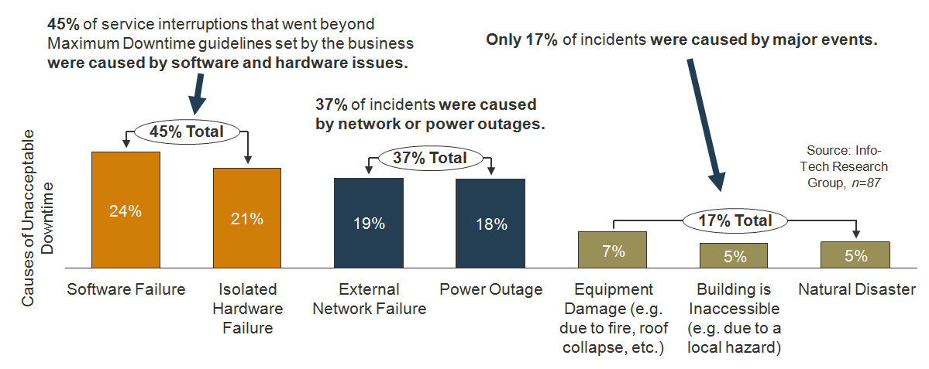

DRPs tend to focus on major disasters, and ignore the more likely causes of service interruption
The most common threats to service continuity are hardware or software failures and network or power outages, not major events such as natural disasters.
Does this mean I don’t need a DRP? No. It means the DRP is more actionable when integrated into your overall service management processes. There is more clarity about when to invoke DR procedures when it’s not an obvious disaster.

Slide 6
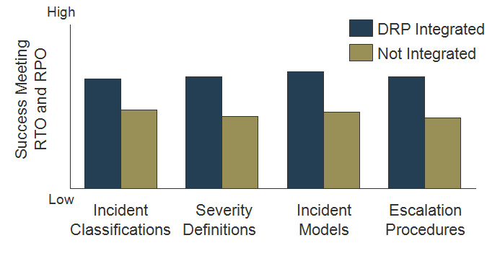
Account for disasters in your service management processes to improve how you respond to less obvious DR scenarios
If a tornado takes out your data center, it’s an obvious DR scenario; for less obvious DR scenarios (e.g. hardware/software issues) that may start with a help desk ticket, it’s often unclear when DR procedures need to take over.
Extending service management processes to account for disaster scenarios bridges that gap, and integrates DR thinking into normal IT operations.
Organizations that account for disasters in their service management processes (e.g. severity definitions, escalation rules, etc.) are much more successful at meeting RTO and RPO requirements
High
Success Meeting RTO and RPO
Low
Extent that Service Management Processes Account for Disasters
High
Source: Info-Tech Research Group, n=92
U.S. organizations are slightly more likely than other countries to incorporate DR into their service management processes (54% vs. 46% for the rest of the world), despite perceptions that U.S. organizations lean more on technology than process.

Slide 7
For example, timelines for when to invoke your DRP help you avoid delays that can jeopardize recovery objectives
IT staff need clarity on when troubleshooting has to stop and recovery procedures begin to avoid unacceptable downtime.
Hardware and software failures tend to fall under normal service management guidelines, but can have the potential to cause prolonged service interruption. Organizations that don’t account for this possibility can fall victim to staff who think “I just need five more minutes” to fix the issue, wait too long before switching to DR procedures, and fail to meet service continuity objectives (e.g. RTO).
Only 30% of respondents in a recent survey had documented timelines for when to declare a disaster in the event of a hardware or software failure; it’s no coincidence that this group had much higher overall success in meeting their RTOs and RPOs, since service interruptions are more likely to be caused by these types of incidents.
High
% With DR Timelines for Hw/Sw Failures
30%
Success Meeting RTO and RPO
% Without DR Timelines for Hw/Sw Failures
70%
Low
Respondents with DR Timelines for Hw/Sw Failures
Respondents without DR Timelines for Hw/Sw Failures
Source: Info-Tech Research Group, n=107

Slide 8
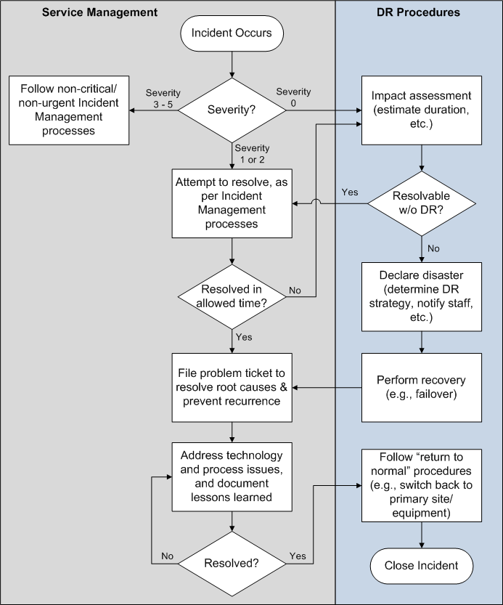
An example of an integrated service management and DR process flow
Severity definitions and escalation rules will determine when DR takes over from service management. As shown in this example process flow:
For an obvious disaster (severity 0 in this example), DR procedures take over immediately. For critical or urgent issues (severity 1 or 2), attempt to resolve within time allowed before escalating to DR procedures.
After the incident is resolved, or DR completed, file a problem ticket to resolve the root cause (e.g. replace faulty primary hardware, address process issues, etc.) and document lessons learned.
After the problem ticket is resolved, return to normal (e.g. switch back to primary site).
Next Steps:
Both service management and DR depend on a solid understanding of system criticality and recovery time/point objectives (RTO and RPO). The next section guides you through making these determinations.
The following section will then guide you through integrating service management and DR, specifically:
  Extending severity definitions to account for disasters
  Defining escalation timelines
  Defining DR timelines

Slide 9

Establish system criticality and recovery objectives with a business impact analysis
BIA tool workflow overview
Create a data collection plan and BIA schedule
Identify Gold, Silver, Bronze systems
Determine the impact of downtime
Identify system components and dependencies
Establish recovery objectives (RPO and RTO)
Perform a risk assessment to identify investment priorities
Get executive approval for BIA and recovery objectives
Why DRPs fail; the solution starts with service management
Establish system criticality and recovery objectives with a BIA
Extending service management to account for DR scenarios
Summary and references

Slide 10
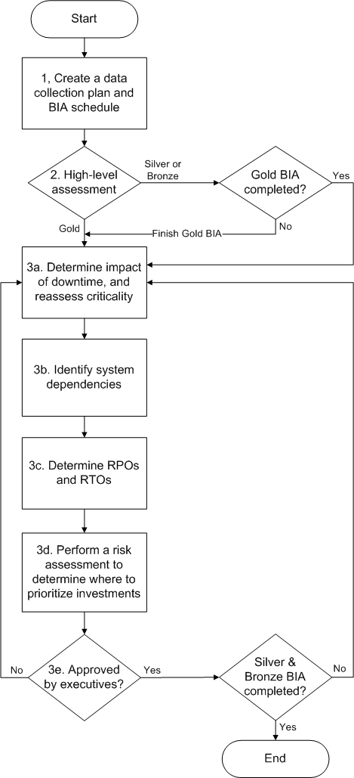
Use Info-Tech’s BIA Workbook to complete a systems inventory, determine criticality, and set RTO and RPO requirements
This section will guide you through completing a business impact analysis (BIA) and the relevant sections of the BIA workbook that is included in this solution set. As shown in this workflow diagram, the steps are:
Create a data collection plan and BIA schedule.
Perform a high-level assessment of which systems (or services) are Mission Critical (referred to here as “Gold” systems), Important (“Silver”), and Not Important for day-to-day operations (“Bronze”).
  This enables you to focus on Gold systems first to establish DR procedures and timelines for your most critical systems, and then continue the process for less critical systems.
For Gold systems:
  Determine the impact of downtime, and reassess criticality.
  Identify system dependencies (i.e. the components that make up the overall system).
  Determine recovery objectives (RPO and RTO).
  Perform a risk assessment to determine where to prioritize investments to meet RPOs and RTOs.
  Review with executives to confirm BIA and recovery objectives.
Repeat step 3 for Silver and Bronze systems.
See Info-Tech’s Business Impact Analysis Workbook.

Slide 11
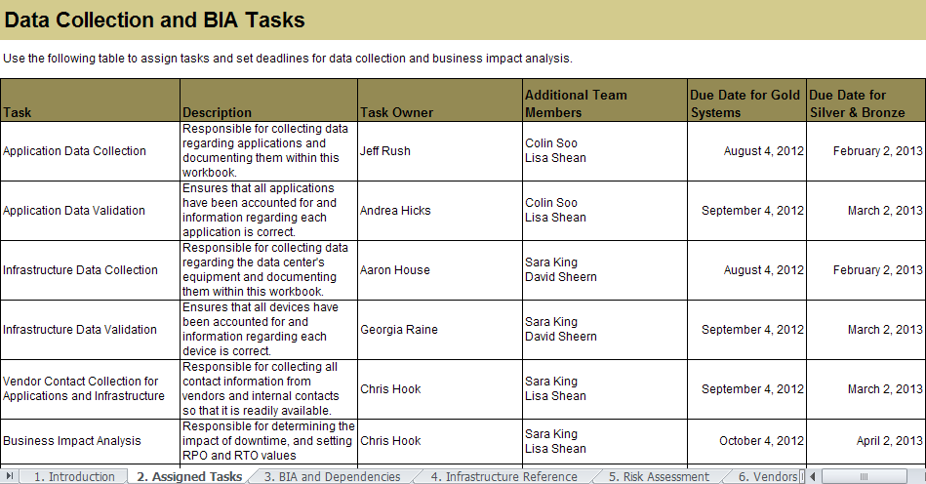
Step 1: Create a data collection plan and BIA schedule
The inventory process alone can take months. Assign task owners and set deadlines to keep this project on track.
Use the “Assigned Tasks” tab in the BIA workbook to assign tasks and set high-level deadlines:
Document task requirements. Include tasks for collecting the data and validating the data.
Assign task owners and identify additional resources that may be required.
Set overall deadlines for task completion.
Refer to Info-Tech’s Project Management Planning and Monitoring Tool for Small Enterprises to incorporate these tasks into a more detailed project plan.

Slide 12
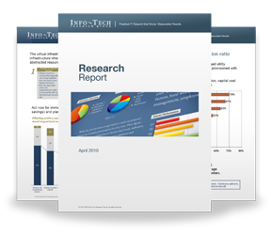

Info-Tech Research Group Helps IT Professionals To:
Quickly get up to speed
with new technologies
Make the right technology
purchasing decisions – fast
Deliver critical IT
projects, on time and
within budget
Manage business expectations
Justify IT spending and
prove the value of IT
Train IT staff and effectively
manage an IT department
Sign up for free trial membership to get practical
solutions for your IT challenges
“Info-Tech helps me to be proactive instead of reactive –
a cardinal rule in a stable and leading edge IT environment.
  - ARCS Commercial Mortgage Co., LP
Toll Free: 1-888-670-8889
www.infotech.com

