Slide 1

Vendor Landscape Plus: Server Virtualization

Slide 2
Introduction
VMware continues to dominate, but selection isn’t just about who is the leader. Competitors are providing legitimate alternatives for consolidation and virtual infrastructure management.
This Research is Designed For:
This Research will Help You:
IT Leaders planning to implement server virtualization to save costs on server hardware.
IT Leaders looking to advance their server virtualization strategy beyond simple consolidation to realize efficiency benefits of a fully managed virtual infrastructure.
IT Leaders planning to develop their virtual environment into a fully automated utility infrastructure (internal cloud).
Organizations considering adopting a hybrid server virtualization strategy (i.e. multiple solutions) to avoid future vendor lock-in and lower cost to serve.
Understand available functionality of current server virtualization software for consolidation, management and utility infrastructure as well as differentiating factors among vendors.
Align vendor strengths and limitations to your current and projected needs around virtualization.
Be able to prepare an RFP and score RFP responses.
Select the vendor that is the best fit for your organization.
Develop implementation plans that address common challenges.

Slide 3
Executive Summary
Understand Trends & Current Issues
Server virtualization enables immediate & continuing cost savings through consolidation, plus significant benefits for server availability, rapid provisioning & disaster recover. For many, it is these management benefits that make the case for virtualization.
Server virtualization is critical to building an automated utility infrastructure (internal cloud); however, less than one-third of virtualizing organizations are seeing benefits in this area.
VMware is the most feature rich, but the most costly solution. Use the Virtualization Consolidation Cost Savings Calculator to evaluate cost savings, and see if Microsoft, Citrix, or Red Hat are good-enough alternatives for your needs.
Evaluate Server Virtualization Vendors
VMware is the market leader with dominant market share, but Citrix, Microsoft, and Red Hat are catching up in core functionality, and offer relative cost savings.
VMware’s product focus is on advanced internal cloud enablement and public-private cloud integration. Citrix has also been developing solutions in this area.
In virtual infrastructure management – where most enterprises currently have needs – it is a tighter bracket between VMware, Citrix, and to a lesser extent, Microsoft and Red Hat, with Red Hat making up considerable ground in 2010.
Arrive at an Implementation Strategy
Tap vendor tools and expertise for virtual migration success; server vendors and virtualization product vendors typically come armed with tools and services for design, configuration, testing, and implementation.
Assess the resource utilization of current servers and plan for appropriate capacity across processors, network, and storage. Leverage server capacity growth for better virtualization.

Slide 4
VMware remains the server virtualization leader, but competitors have emerged with attractive alternatives
There are five primary competitors in the server virtualization (SV) market:
  VMware has been, and still remains, the overall leader in market share and core capabilities.
  Citrix XenServer is a close second in terms of leading features, with a much lower price point, but lags far behind in market share.
  Microsoft is an emerging competitor – late to the party and competitively priced, it is a genuinely viable alternative with the release of Hyper-V R2, and increasing in market share.
  Red Hat’s Enterprise Virtualization is an emerging player that has quickly ramped up its feature set since standardizing on the KVM (Kernel Virtual Machine) hypervisor .
  Oracle offers capable virtualization through its Xen-based OVM (Oracle Virtual Machine) and management enhanced by acquisition of Sun Microsystems’ virtual products.
Info-Tech Insight
Focus on business requirements:
The first step in selecting a server virtualization vendor is to determine the functionality that your organization requires to meet business needs or justify an investment in server virtualization.
2) Consider future requirements:
VMware leads innovation around building a utility infrastructure (or internal cloud). However, Citrix also has a clear vision for future development, and Microsoft has been catching up in key functionality. If current or future needs involve internal cloud VMware and Citrix are safe choices.
3) Go for good enough:
Align current and future requirements with the capabilities and solution feature-sets of vendors. While VMware is the market leader, its higher cost makes it critical to assess whether an alternative vendor can meet your organization’s needs.

Slide 5

Understand Trends and Current Issues
This section will help you to:
Sections:
Understand the benefits & costs of more heavily virtualizing your current environment.
Get a handle on the current market & recent differentiators.
Formulate a cost/benefit analysis to demonstrate the value & justify the cost of future virtualization plans.
Understand Trends & Current Issues
Evaluate Server Virtualization Vendors
Arrive at an Implementation Strategy

Slide 6
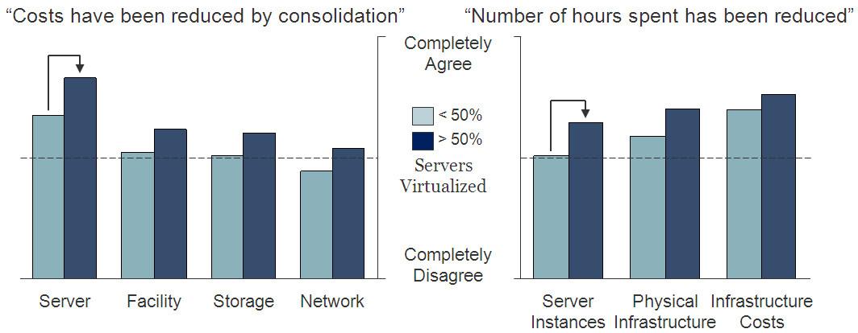
Capital cost savings in server hardware is the most immediate benefit of server virtualization. Operations also benefit.
Organizations implementing server virtualization often avoid costly hardware upgrades up front and improve ongoing management of their servers
Info-Tech finds that servers are the primary source of cost savings associated with server virtualization & consolidation – averages above the dotted line indicate agreement that cost/hours have been reduced. As organizations become more virtualized these cost savings continue to become more prominent – organizations that are highly virtualized are more likely to see cost/time savings than those less virtualized.
N = 88. Source: Info-Tech Research Group.

Slide 7
Beyond server consolidation, enterprises are realizing significant benefits from a managed virtual infrastructure
Benefits can be grouped into three broad categories:
Consolidation:
For new server hardware, more can be done with less as multiple workloads (running on virtual machines) more effectively utilize shared physical servers. CAPEX savings can range from 40% to 75%.
Management:
Virtual machines can be created and configured much more rapidly than physical servers. High availability and rapid recovery can also be architected much more cheaply than physical servers. This has time and cost savings benefits for ongoing management and business continuity planning.
Automation (Internal Cloud):
Virtualization does not magically make a private cloud appear; however, in moving to internal infrastructure-as-a-service (or private cloud), a virtual infrastructure is more agile. Virtualization vendors are incorporating automation, self-service, and cost accounting (metering) features into their management stacks to enable the creation of cloud-like internal services.
Vendors such as VMware and Citrix are also working on standards and functionality for bridging between these internal clouds and public Infrastructure as a service clouds.
Lowered OPEX (fewer servers to manage)
Reduced CAPEX (fewer server purchases)
Energy Savings (smaller footprint)
Easier server maintenance
Faster application provisioning
Improved application performance
Higher availability
More reliable DR capabilities
Streamlined capacity management/planning
Automated virtual server management
User self service
Improved visibility for metering/charge-backs

Slide 8
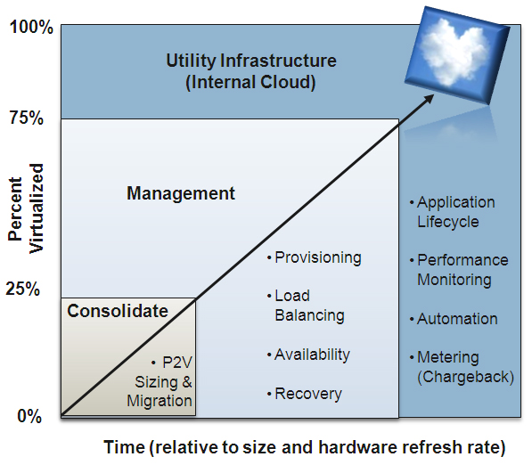

Server virtualization solutions deliver features that enable consolidation, agile management, and internal cloud
Info-Tech sees virtualization as a journey that starts with CAPEX savings, but progresses through management to cloud as more servers are virtualized
Consolidation Phase:
The focus is on transitioning workloads to virtual machines and getting the most out of the hardware (most VMs per host). Capacity analysis and P2V (physical to virtual) migration tools and features that boost consolidation ratio are most important value add features in this phase.
Management Phase:
Virtual infrastructure has become a core technology hosting production servers. Rapid agile provisioning, resource scheduling and load balancing, and high availability are key features in this phase. Optimization of shared storage resources is also critical.
Internal Cloud Phase:
Focus shifts to end-to-end management of complete systems from application through virtual machines to hardware. Performance monitoring for service level maintenance as well as management automation and self-service are key to building infrastructure as a service. Automated cost accounting for chargeback or “showback” also brings cloud-like capability to the virtual infrastructure.
Smaller enterprises (i.e. 25 to 250 servers) rapidly progress to the management phase because they virtualize more servers faster (up to 65% in a single year). They have less to gain in capital savings (less to virtualize) but want the agility and availability benefits of a virtual infrastructure.

Slide 9
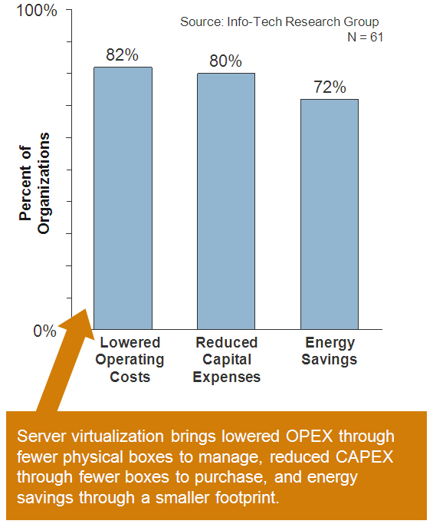
Phase One: Consolidate to reduce server capital expenses, lower operational costs and save energy
Consolidation ratios are important, but not the “be all” and “end all”, as competitors have largely caught up to VMware
Consolidation ratios are not a significant vendor differentiator:
Don’t get hung up on vendor claims of consolidation ratios as this only matters for very large enterprise seeking economies of scale through maximum workloads per physical host.
Much hype has been generated over technologies for improving the number of VMs that can run on a physical host, primarily because VMware promotes these as a means of lowering total cost per VM.
VMware achieves most of its memory optimization through a flavor of memory over-commitment called ballooning, which is the same technology used in Citrix & Microsoft’s dynamic memory capabilities. Red Hat accomplishes this with transparent page sharing & hypervisor paging, also used by VMware.
Physical-to-Virtual (P2V) involves transitioning of physical servers to VMs and candidate server identification. VMware & Citrix (except Windows Server 2003) allow machines to be migrated without downtime to the server; Microsoft does not.
Virtual-to-Virtual (V2V) primarily differs among vendors in that Citrix and Microsoft allow migration of VMs from VMware ESX hosts, whereas VMware’s proprietary software does not support migration of VMs from XenServer or Hyper-V hosts.

Slide 10
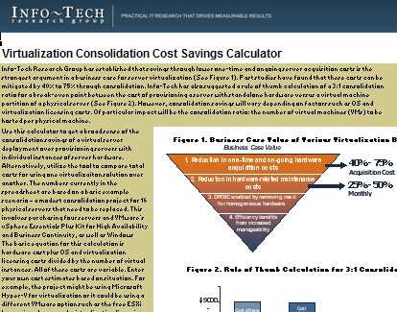
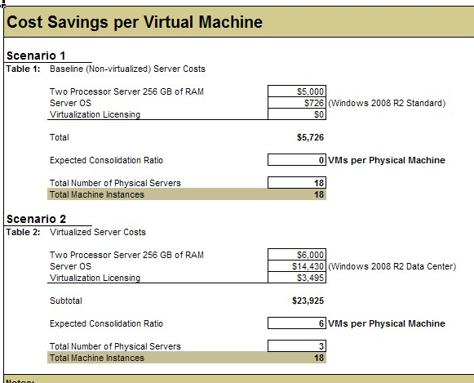
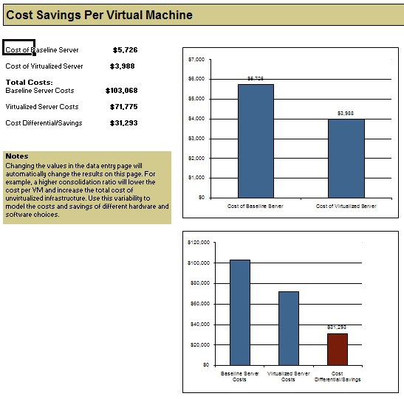
Use Info-Tech’s Virtualization Consolidation Cost Savings Calculator to compare savings across solutions
The Virtualization Consolidation Cost Savings Calculator should be used to derive a rough estimate of potential cost savings for consolidating servers relative to a net new server purchase.
Use this calculator to:
Get a sense of the cost difference (savings) of consolidating servers in a virtual environment against the cost of buying individual physical servers for each application.
Measure the impact on savings of various virtualization solutions and Windows licensing options.
Weigh the impact on overall savings of increasing and decreasing the number of virtual instances per physical machine (the consolidation ratio).
Microsoft has improved their server licensing over the years by allowing unlimited Microsoft server virtual instances to share a single licensed physical server. This privilege, however, comes at the price of having to purchase the more expensive Windows 2008 Data Center Edition. Under this model, pricing is based on the number of host servers, and the number of processors on each.

Slide 11
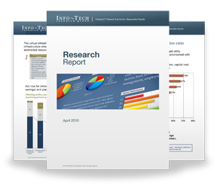

Info-Tech Research Group Helps IT Professionals To:
Quickly get up to speed
with new technologies
Make the right technology
purchasing decisions – fast
Deliver critical IT
projects, on time and
within budget
Manage business expectations
Justify IT spending and
prove the value of IT
Train IT staff and effectively
manage an IT department
Sign up for free trial membership to get practical
solutions for your IT challenges
“Info-Tech helps me to be proactive instead of reactive –
a cardinal rule in a stable and leading edge IT environment.
  - ARCS Commercial Mortgage Co., LP
Toll Free: 1-888-670-8889
www.infotech.com

